Slide 1
APS CHORUS Implementation
Mark Doyle
Director, Journal Information Systems
American Physical Society
CHORUS TWG, Chair
February 3, 2015

Slide 2
APS Background
Almost 20,000 articles published annually
Internal technical teams
  Journals hosted on our own platform
  Submissions server and peer-review system homegrown
Multiple typesetting vendors
Migrated to JATS over past year
Archiving with Portico

Slide 3
Business Decisions
Use author manuscript (AM) for non-Gold-OA articles, publicly available one year from publication date
Use version of record (VOR) for Gold-OA articles (CC-BY 3.0), immediately available
For pilot: 12,000 (4% Gold OA) articles selected from January 2011 through June 2013.
Create default license pages (placeholders)

Slide 4
APS Licenses for Re-use
http://journals.aps.org/licenses
Multiple URLs resolve to this page – need to split these out and version them
  http://link.aps.org/licenses/aps-default-license (for VOR)
  http://link.aps.org/licenses/aps-default-accepted-manuscript-license (for AM)
  http://link.aps.org/licenses/aps-default-text-mining-license (for TDM)

Slide 5
Accepted Manuscript Implementation
Scrub PDFs to remove “Not for Distribution – For Review Purposes Only” and manuscript tracking number (really just a check now for older papers)
Import into journal platform asset store with public access start date (publication date + one year)
Adapt authentication system and block accepted manuscripts for authenticated subscribers
Prevent Google indexing of accepted manuscripts
Add cover page with publication information and DOI

Slide 8
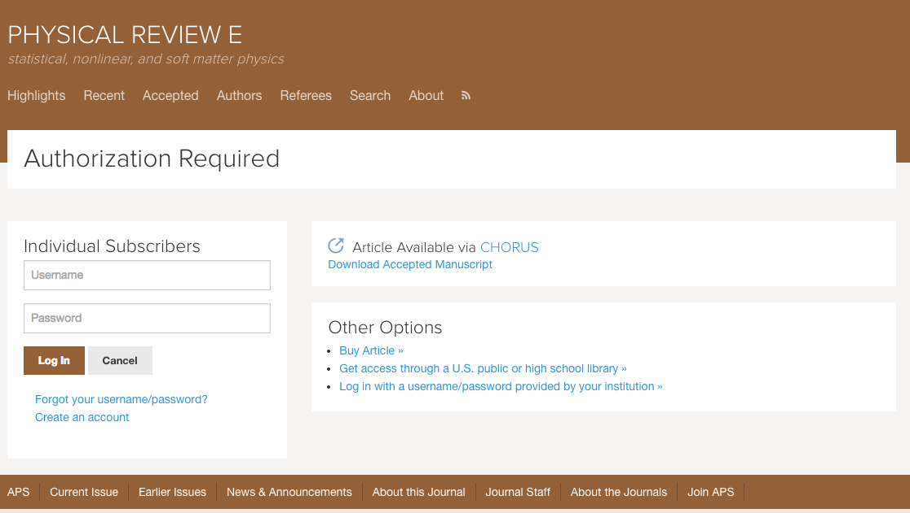

Slide 10
FundRef Implementation
Take information from author acknowledgments
Capture in JATS XML using 1.1d1 DTD (see similar example in implementation guide)
Authors are asked at proof stage to check
Will evaluate adding to submissions system interface in future

Slide 12
Production
Live production pipeline now in place for DOE articles (CrossRef updates coming soon)
  AM’s automatically stored with cover page upon publication
  Embargo date set
  Backfilled to August 1, 2014 for DOE (set to DOE public access plan announcement date and ahead of Oct 1, 2014 start date)

Slide 13
API for Full Text Indexing
CHORUS publisher membership agreement calls for allowing full text indexing by agencies who sign an agreement with CHOR, Inc.
Testing in progress for new token-based authentication mechanism
  https://api.chorusaccess.org/agency-auth/token/validate/hZqJDbcbKSSRgRG_PJxSBAx
APS API implementation almost complete

Slide 14
CHORUS TWG
Broad membership (more than a dozen organizations represented)
Biweekly teleconferences on Monday mornings (11:30 AM New York) (mailing list, Trello board)
We discuss a wide range of topics and identify best practice
Contact Howard or me if you are interested in joining

Slide 15
More information
http://www.chorusaccess.org/resources/publisher-implementation-guide
Contact Howard Ratner (hratner@chorusaccess.org) or me (doyle@aps.org)
Join TWG
Watch for additional webinars

