Slide 1
CHORUS: Perspectives from a Platform Provider
Matt Hirst
mhirst@silverchair.com
434-220-8479

Slide 2
Outline
CHORUS – Basic Overview
Platforms – Back-end Updates
Platforms – Front-end Updates
Recommendations
Questions?

Slide 3
CHORUS – Basic Overview
What Do Publishers Need To Do?
Collect funder information (via your manuscript tracking system or by extracting from your articles) and map it to entries in the CrossRef Funder Registry
Send the funder information to CrossRef’s FundRef system
Link to a common license or post your proprietary license for content reuse on your site
Make at least one version of your articles reporting on funded research publicly accessible on your website, either Version of Record (VOR) or Accepted Manuscript (AM), with an appropriate embargo period if desired
Send to CrossRef the URL for the publicly accessible version paired with the URL for the reuse license with an appropriate start date commensurate with the chosen embargo period
Permit your publicly accessible versions to be harvested for indexing by agencies (agencies will link back to you by the DOI)
Archive the AM or VOR at a recognized archive service
Source: http://www.chorusaccess.org/resources/simple-guide-to-participating-in-chorus/
Notes:
Where does Silverchair (or your platform provider) fit into the overall process?

Slide 4
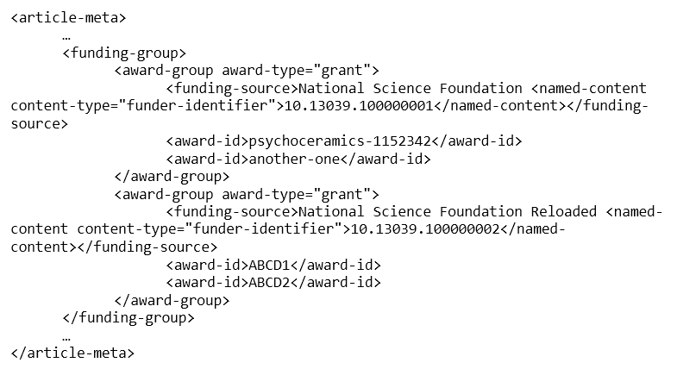
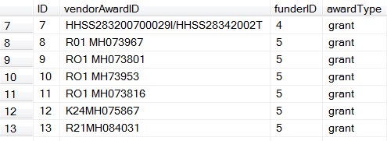
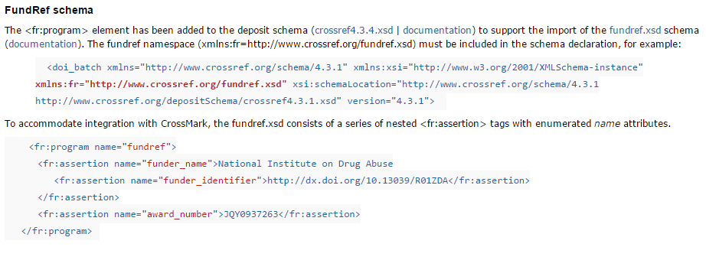
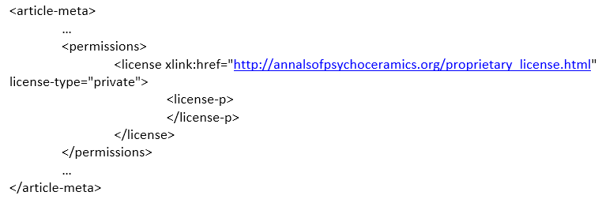
Platforms – Back-end Updates
Update XML Guidelines, Content Processing Capabilities
Update Related Data Structures, Access Controls
Update CrossRef for Funding & Licensing Metadata

Slide 5
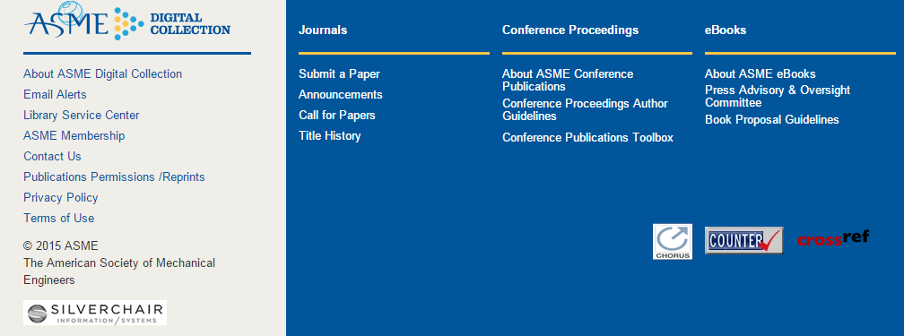
Platforms – Front-end Updates
Update licensing information/pages (as needed) and front-end display for funding information, CHORUS & FundRef signage. Funding information can also be included in article display via CrossMark.

Slide 6
Recommendations
If you are interested in participating in CHORUS, engage your service provider/partners early in the conversation.
VOR vs. AM (different publishers, different requirements)
Think about and understand the consequences to your workflow and the entirety of the process/requirements.
Compliance/Licensing Strategy (business decisions too)
Be prepared to be flexible, patient and keep an open line of communication with your partners as FundRef and CHORUS continue to grow and evolve.
Access Control via Funder Embargo
Maintaining Funder Embargo Data

Slide 7
Thank you!
Questions?
Matt Hirst
mhirst@silverchair.com
434-220-8479

