Slide 2
ASME Publishing and CHORUS
Colin McAteer
Manager, Journals
mcateerc@asme.org
December 18, 2014

Slide 3
FundRef Integration and CHORUS Participation
Funder Data Collection
Licensing
Recommendations

Slide 4
Funder Data Collection

Slide 5
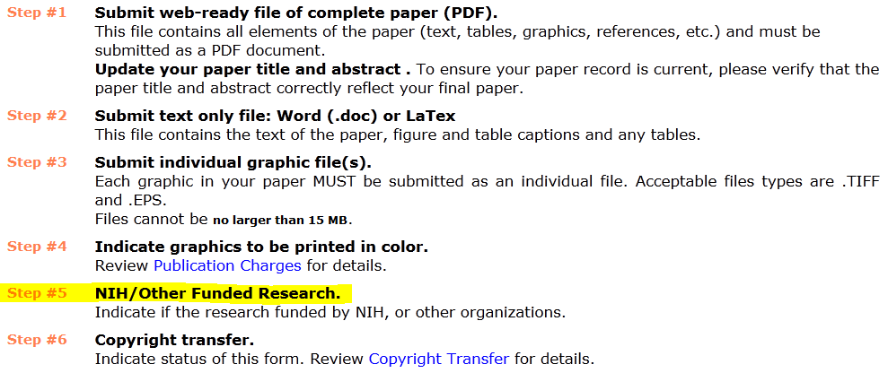
Funder Data Collection Start: September 2014
Funding information requested from authors as part of submission of production files.

Slide 6
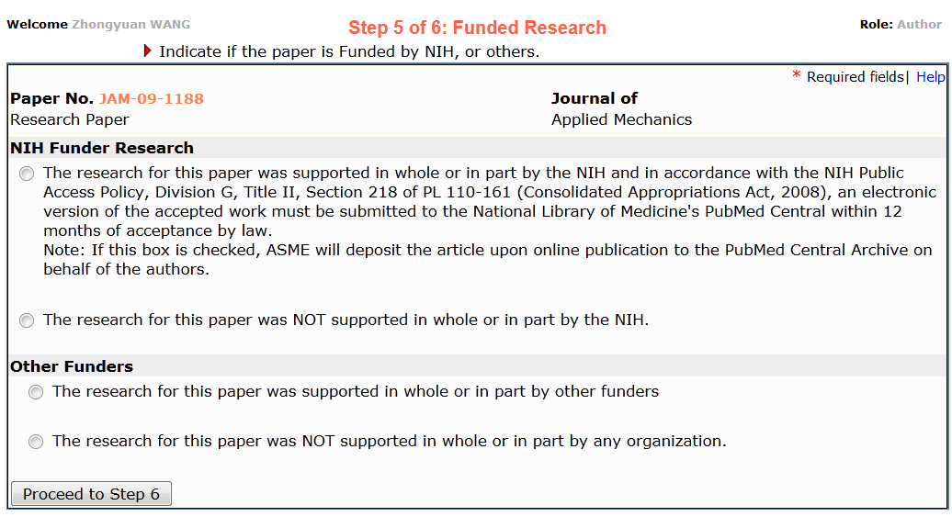
Funder Data Collection Data collection added to in-house peer-review application.
Required for all submissions.

Slide 7
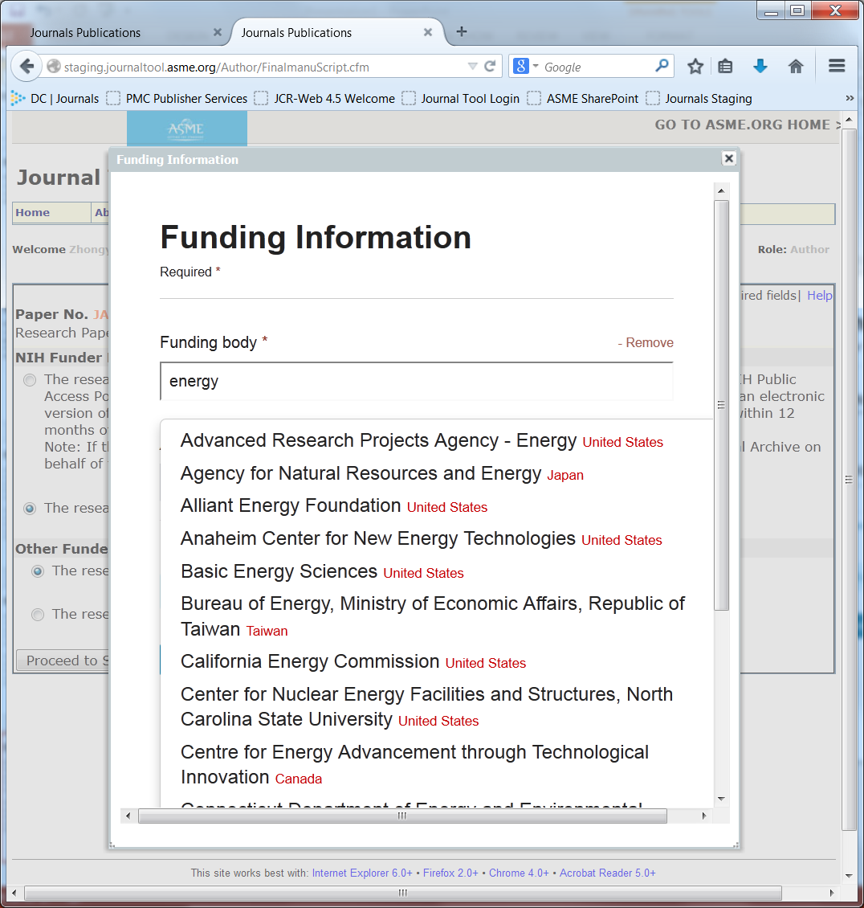
Funder Data Collection Initial implementation using “out of box” CrossRef widget

Slide 8
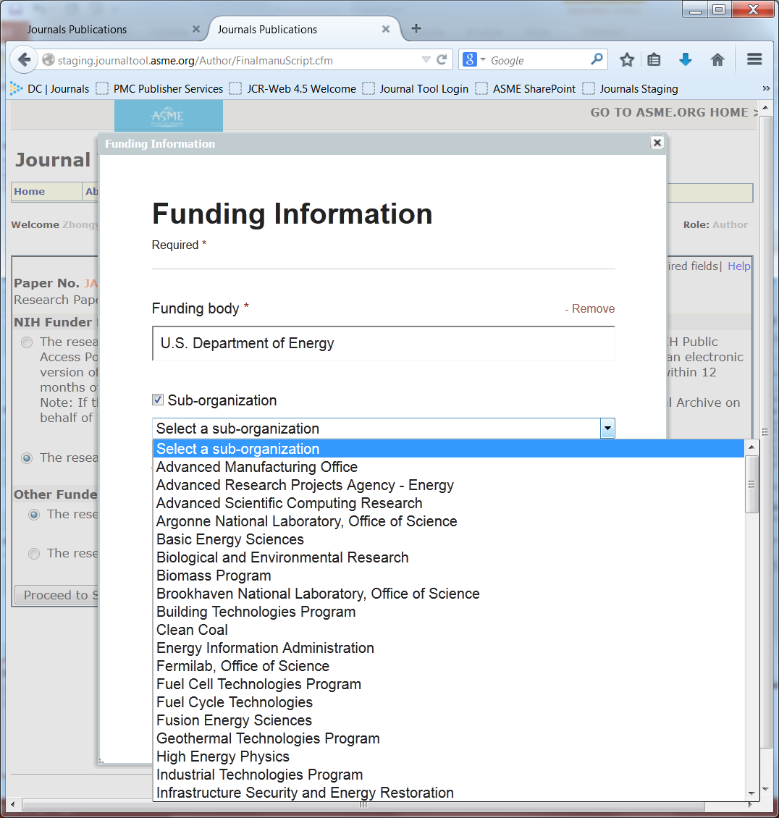
Funder Data Collection Sub-organization data collected.

Slide 9
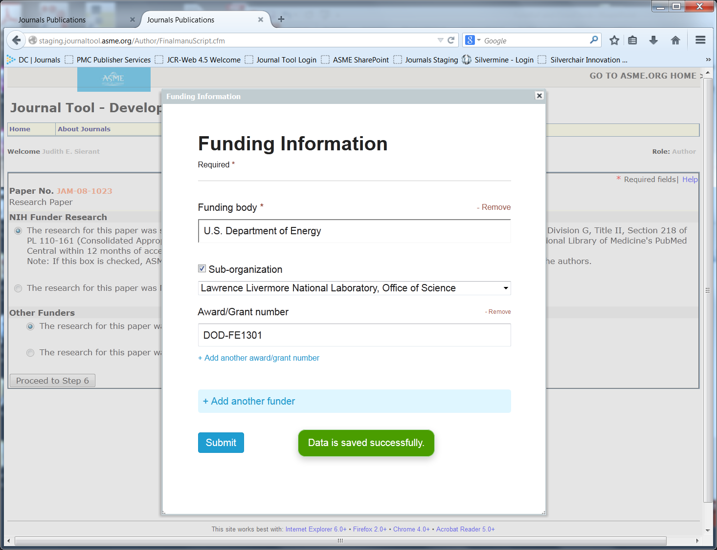
Funder Data Collection Funding body and award/grant required.

Slide 10
Initial Data Collection Model
FundRef Data Collection
Submission
Peer Review
Final Submission
Author Proof
Publication
XML Composition
Accepted MSS Publication
Results:
58% No Funder ID
28% OSTP Agencies

Slide 11
Revised Data Collection Model
FundRef Data Collection first request
FundRef Data Collection third request
finalize
Submission
Peer Review
Final Submission
Author Proof
Publication
XML Composition
Accepted MSS Publication
FundRef Data Collection second request clarification
Status:
In Progress for JAN 2015

Slide 12
Modifications/Lessons Learned
Separate US Funding Agencies – checkbox for author
Include two-step data collection:
1. selection from FundRef list
2. provide Funder name if not found
Validate and submit Funder names to CrossRef concurrently with peer review so files enter production complete with Funder ID.
Create a Funder section in papers using submitted funder information.
Have conversion vendors validate additions/corrections during proof review.

Slide 13
Licensing

Slide 14
Licensing and Access
Launch
(first quarter 2015)
ASME Copyright Transfer Agreement
VOR deposited and made available through CHORUS
OSTP Agencies +12 months

Slide 15
Licensing and Access
Phase 2
(fourth quarter 2015)
ASME Open Access Journal
CC BY-NC-ND
VOR through CHORUS

Slide 16
Recommendations

Slide 17
Best Practice
Concurrent to Funder Data Collection
Vendor Prep
Conversion– validating Funder information in proofs
Hosting – funding/license deposits and platform mods for display
JATS conversion
CrossMark integration
Author Education

Slide 18
ASME Publishing and CHORUS
Colin McAteer
Manager, Journals
mcateerc@asme.org
December 18, 2014

