Slide 1

ACS Publications and CHORUS
Dan O’Brien
Publications Technology
ACS Publications
dobrien@acs.org
18-Dec-2014

Slide 2
ACS Publications
Publishing program
50 journal titles
>40,000 published articles
350,000 published pages
Technology
Submission: ScholarOne Manuscripts
Production: Internal XML-based system
  Vendor XML conversion
  Internal editing & automated composition
Delivery: Atypon Literatum

Slide 3
► Article Versions ◄
Capturing Funding Information
CHORUS Metadata Deposits
Fun with the CrossRef API

Slide 4
Which Version of the Article is part of CHORUS?
The OSTP Memo mentions the following as acceptable for complying with public access requirements:
  Accepted Manuscript (“AM”)
  Version of Record (“VoR”)

Slide 5

ACS Options for Public Access Compliance
Key:
Free to author/institution
Author/institution charges may apply
ACS services to help authors with public access compliance
License Options
  ACS AuthorChoice license (~CC-BY-NC)
    CC-BY-NC-ND and CC-BY options available
  ACS Journal Publishing Agreement
Content Availability Compliance Options
  Author self-deposits AM version
  ACS makes VoR publicly accessible
    ACS AuthorChoice: Immediately open
    ACS AuthorChoice+12: open availability 12 months after publication
  ACS deposits VoR: ACS Certified Deposit
Auto-deposit of funding & license metadata to CrossRef

Slide 6
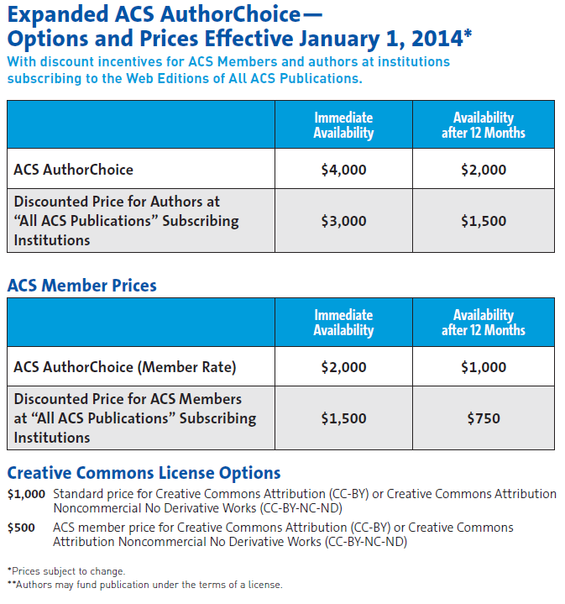
http://acsopenaccess.org/acs-authorchoice/

Slide 7
Article Versions
► Capturing Funding Information ◄
CHORUS Metadata Deposits
Fun with the CrossRef API

Slide 8
ACS Procedure for Capturing Funding Information
Submission (via ScholarOne Manuscripts, “S1M”)
  Author Entry
    Prompted by S1M to enter funding information as part of manuscript submission process
    Response now required at Revision.
  ACS Validation
    At Revision only
    ACS BPO vendor compares:
      Manuscript’s Acknowledgment text (authority)
      Author’s funding data entries within S1M
    Vendor updates S1M funding data based on Acknowledgement
  Funding info sent to Production via S1M metadata feed
Galley correction updates (under development)
  Author Reviews: Funding info displayed on Proof Review site
  ACS Updates: Funding info updated by ACS staff per Author request

Slide 9

ACS Procedure for Capturing Funding Information
ACS
1b. Update FundRef data from Acknowledgement
(at Revision)
2b. Update FundRef data per Author request
Article Publication
Submit
Peer Review
Accept & Prep
Conversion,
Editing,
Production
Galley Proof
FundRef Data
Issue Publication
ScholarOne Manuscripts
ACS internal production system
1a. Enter FundRef data into submission fields
2a. Review FundRef data
Atypon Literatum
Author

Slide 10
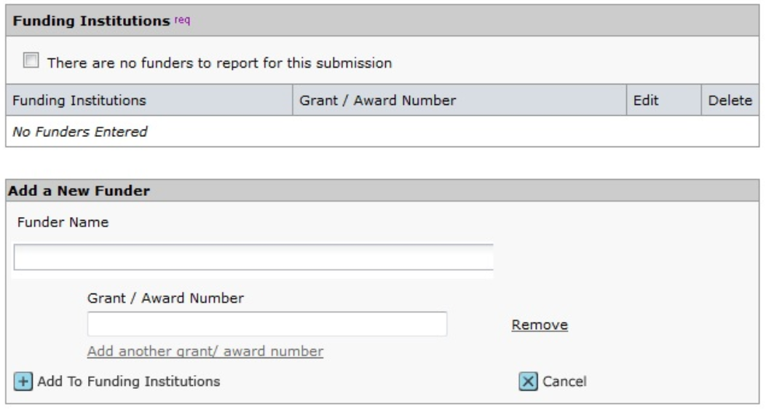
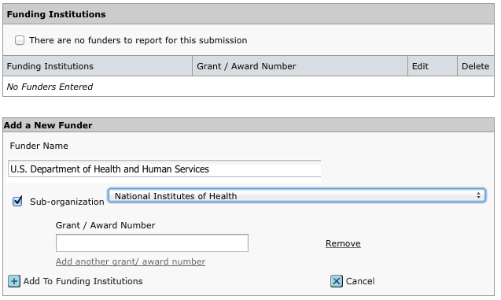
ACS Procedure for Capturing Funding Information – S1M screens

Slide 11
Experiences with Funding Agency Identification
Sept 2013: Initial launch of voluntary, author-supplied data.
  Low author uptake
Feb 2014: ACS BPO vendor review & corrections started.
June 2014: Funding fields became required (revisions only)
  Can select “No funding to report”
    2.0: Average funding agencies per article (up from 1.5)
    15: Most funding agencies found per an article (up from 11)

Slide 12
Experiences with Funding Agency Identification – Accuracy Improving
November 2014 vs. July 2014
60% Authors entered funding info, up from 50%
29% Articles with missing funding data, down from 37%
2014
2014

Slide 13
Experiences with OSTP Agency Identification

Slide 14
ACS Funding Data Capture:
Future Plans
Author Education:
Expand author education about open access mandates and their relation to the funding data capture and deposit
Updates to informational and instructional pages for authors
Process Enhancements:
Enable funding info updates during Proof process

Slide 15
Article Versions
Capturing Funding Information
► CHORUS Metadata Deposits ◄
Fun with the CrossRef API

Slide 16
FundRef and License Metadata Deposits
In 2013:
ACS’ instance of Atypon/Literatum was not yet ready to handle funding and license metadata
  Required software upgrade (now done)
  Required changes to production interface (pending)
ACS developed its own FundRef & License metadata deposit process
    deposited directly to CrossRef from ACS journal Production system
    occurs after basic DOI registration deposit by Literatum
    uses partial deposit schema
Yet to come – any refinements to deposit to Portico.

Slide 17
Workflow for FundRef/License Metadata Deposits to CrossRef
?? Funding Info to Portico
4. Content → Portico
5. ACS Certified Deposit
ACS
3b. FundRef & license data → CrossRef
3a. DOI deposit → CrossRef
1b. Update FundRef data from Acknowledgement
(at Revision)
2b. Update FundRef data per Author request
Article Publication
Submit
Peer Review
Accept & Prep
Conversion,
Editing,
Production
Galley Proof
FundRef Data
Issue Publication
ScholarOne Manuscripts
ACS internal production system
1a. Enter FundRef data into submission fields
2a. Review FundRef data
Atypon Literatum
Author

Slide 18
Article Versions
Capturing Funding Information
CHORUS Metadata Deposits
► Fun with the CrossRef API ◄

Slide 19
ACS Publications and CHORUS
Dan O’Brien
Publications Technology
ACS Publications
dobrien@acs.org
18-Dec-2014

Slide 20
Example XML for FundRef and License metadata deposits:
The Header
<?xml version='1.0' encoding='UTF-8'?>
<doi_batch xmlns:ns2=http://www.crossref.org/fundref.xsd
xmlns=http://www.crossref.org/doi_resources_schema/4.3.2
xmlns:ns3="http://www.crossref.org/AccessIndicators.xsd" version="4.3.2">
<head>
<doi_batch_id>bi401034q-969</doi_batch_id>
<depositor>
<name>American Chemical Society</name>
<email_address>cruser@acs.org</email_address>
</depositor>
</head>
<body>
[DOI RESOURCE BLOCK…]
</body>
</doibatch>

Slide 21
Example XML for FundRef metadata deposits
<fundref_data>
<doi>10.1021/bi401034q</doi>
<ns2:program name="fundref">
<ns2:assertion name="fundgroup">
<ns2:assertion name="funder_name”>NIH Office of the Director
<ns2:assertion name="funder_identifier">10.13039/100000052</ns2:assertion>
</ns2:assertion>
<ns2:assertion name="award_number">PO1 DK096990</ns2:assertion>
</ns2:assertion>
<ns2:assertion name="fundgroup">
<ns2:assertion name="funder_name”>NIH Office of the Director
<ns2:assertion name="funder_identifier">10.13039/100000052</ns2:assertion>
</ns2:assertion>
<ns2:assertion name="award_number">U19 AI068021</ns2:assertion>
</ns2:assertion>
</ns2:program>
</fundref_data>

Slide 22
Example XML for License metadata deposits
<lic_ref_data>
<doi>10.1021/pr500813f</doi>
<ns3:program name="AccessIndicators">
<ns3:license_ref start_date="2015-11-03-05:00" applies_to="vor">
http://pubs.acs.org/page/policy/authorchoice_termsofuse.html
</ns3:license_ref>
</ns3:program>
</lic_ref_data>

Slide 23
Fun with the CrossRef API
See documentation: https://github.com/CrossRef/rest-api-doc/blob/master/rest_api.md
Example: http://api.crossref.org/prefixes/10.1021/works?filter=has-funder:true&rows=50&offset=100
  /prefixes/10.1021 = ACS
  /works = find all DOIs
  ?filter= = set conditions on the API request
  has-funder:true = filter for only works having a funder id
  &rows = # of items to display
  &offset = starting record number

Slide 24
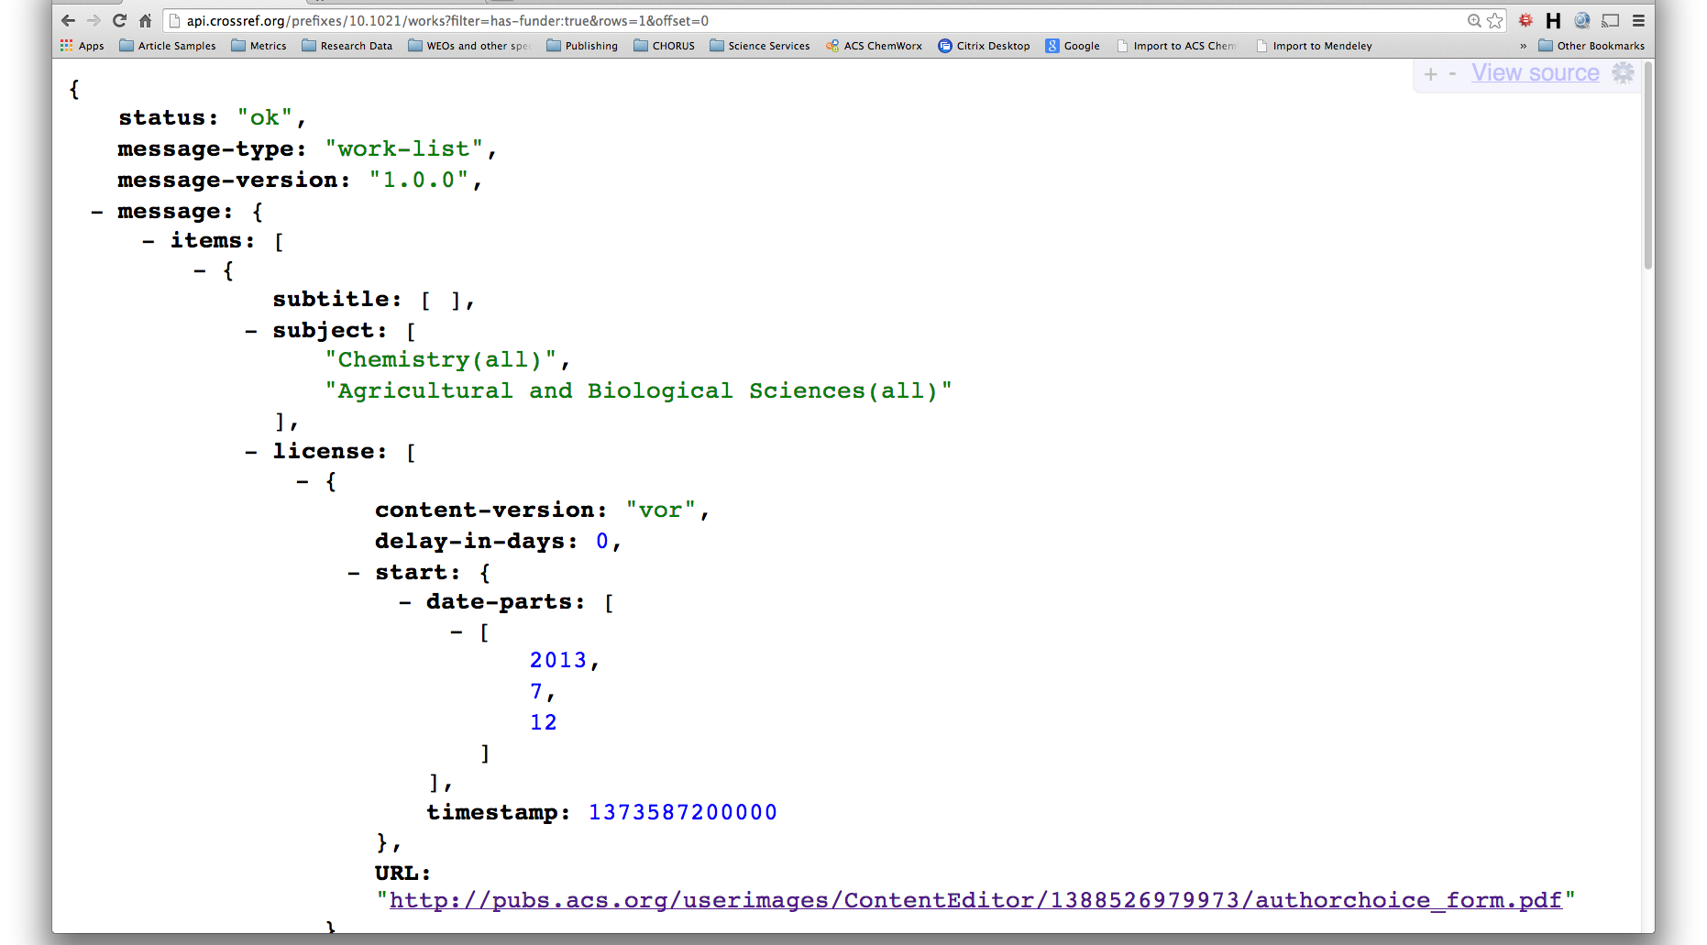
Fun with the CrossRef API

Slide 25
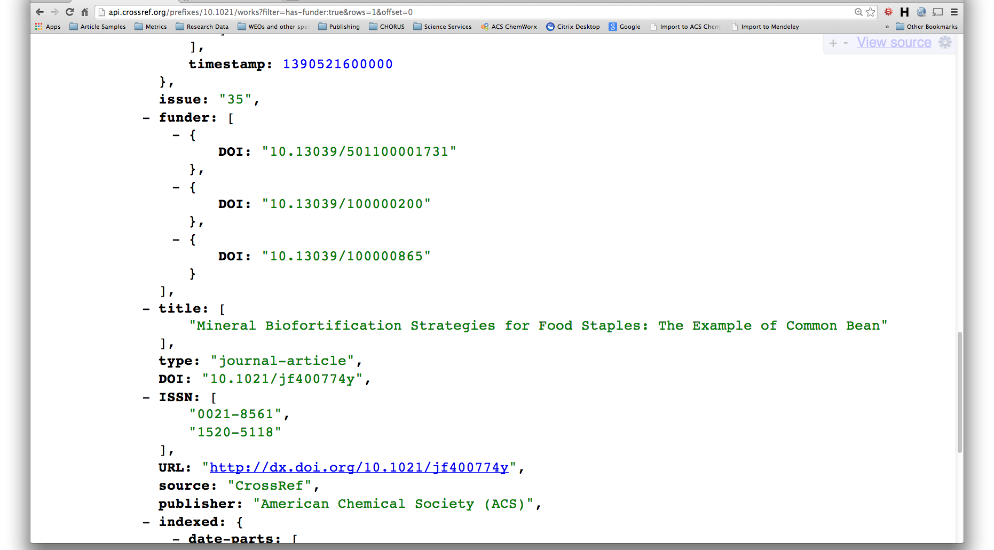
Fun with the CrossRef API

Slide 26
Acknowledgments
ACS Publications
  Susan King – Darla Henderson
  Rose McCord – Dave Martinsen
  Terri Lewandowski – Rob O’Dell
ACS IT
  Rise Schnizlein – Craig Asplund
  John Lindsey

