Slide 1
Agenda
2:00-2:10 Welcome - Howard Ratner, CHORUS
2:10-2:30 CHORUS Overview - Howard Ratner, CHORUS
Publisher Implementations
2:30-2:45 Mark Doyle, APS
2:45-3:00 Colin McAteer, ASME
3:00-3:15 Dan O’Brien, ACS
3:15-3:30 Chris Shillum, Elsevier
3:30-4:00 Q&A / Wrap up - Mark Doyle, APS
5:00-7:00 Holiday Drinks @ W Hotel

Slide 2
Implementation Workshop
18 December 2014
Howard Ratner, Executive Director
CHOR Inc.
Identification • Discovery • Access • Preservation • Compliance

Slide 3
Open Access Funder Mandates
courtesy of Oxford University Press

Slide 4

Increasing Access to the Results of Federally Funded Scientific Research
All federal agencies funding $100M or more annually in extramural research must develop public access plans
Free public access to peer-reviewed research articles (guideline: 12-month embargo, adapted to agency/discipline need)
Ensure interoperability and long-term stewardship
Need plans for both articles and data
Issued February 2013
Agency plans under
development with OSTP
DOE issued plan
24 July 2014
Notes:
One of the main drivers for the formation of CHORUS was the Office of Science & Technology Policy Memo issued in February 2013.
The memo was issued to US agencies:
- All federal agencies funding $100M or more annually in extramural research must develop public access plans
- Free public access to peer-reviewed research articles (guideline: 12-month embargo, adapted to agency/discipline need)
- Ensure interoperability and long-term stewardship
- Need plans on both articles and data
Draft plans were submitted during Fall and Winter of 2013
OSTP replied to agencies in March; agencies replied in May/June; some agencies received final word this summer others this fall.

Slide 5















Members
PLUS OVER 130 SIGNATORIES

Slide 6
Supporting Organizations (December 2014)
AAAS
Acoustical Society of America
ACSESS
American Association of Anatomists
American Association for Cancer Research
American Association of Physicists in Medicine
American Association of Physics Teachers
American Astronomical Society
American Chemical Society
American Crystallographic Association, Inc.
American College of Chest Physicians
American College of Physicians
American Dental Association
American Diabetes Association
American Geophysical Union
American Inst of Aeronautics and Astronautics
American Institute of Biological Sciences
American Institute of Chemical Engineers
American Institute of Physics
American Mathematical Society
American Meteorological Society
American Medical Association
American Nuclear Society
American Physical Society
American Physiological Society
American Psychiatric Publishing
American Psychological Association
American Society for Biochemistry and Molecular Biology
American Soc of Agricultural & Biological Engineers
American Society of Agronomy
American Society of Civil Engineers
American Society of Hematology
American Society of Mechanical Engineers
American Society for Microbiology
American Society of Neuroradiology
American Society of Plant Biologists
American Speech-Language-Hearing Association
Asociacon Columbiana de Infectologia
Assoc for Computing Machinery (ACM)
Assoc for Research in Vision and Ophthalmology
AVS: Science & Technology of Materials, Interfaces and Processing
Biophysical Society
Bioscientifica
Botanical Society of America
British Editorial Society of Bone & Joint Surgery
BMJ
Cambridge University Press
Columbia University Press
The Company of Biologists
Crop Science Society of America
Dove Press
Duke University Press
Ecological Society of America
ECS - The Electrochemical Society
EDP Sciences
Elsevier
Emerald Group Publishing Limited
The Endocrine Society
Entomological Society of America
European Respiratory Society
Fabricators and Manufacturers Association, International
Genetics Society of America
GeoScienceWorld
Hindawi
Human Factors and Ergonomics Society
IEEE
iMedPub. Internet Medical Publishing
INFORMS
Institute of Physics Publishing
Institution of Engineering and Technology (IET)
Journal of Bone and Joint Surgery
Journal of Infection in Developing Countries
Journal of Rehabilitation Research and Dev
Lynne Rienner Publishers, Inc.
Materials Research Society
McGraw-Hill
Mycological Society of America
Nature Publishing Group
New England Journal of Medicine
Now Publishers
The Optical Society
Oxford University Press
The Physiological Society
Revista Medica de Risarlda
The Rockefeller University Press
The Royal College of Psychiatrists
The Royal Society
Royal Society of Chemistry
Sage Publications
Society for the Advancement of Materials on Process Engineering
Society for the Study of Reproduction
Soil Science
Society of America
Springer Science+Business Media LLC
Taylor & Francis
Thieme Publishers
University of Chicago Press
John Wiley & Sons
Wolters Kluwer Medical Research
Plus 10 more service providers & organizations
Notes:
You can see that there are a wide variety of organizations represented here.
From small to large and non-profit to commercial.
Purely American to international
Note the RSC, Royal Society, Nature Publishing Group, Taylor & Francis

Slide 7

Board Members
David Crotty, Oxford University Press
Scott Delman, ACM
Fred Dylla, American Institute of Physics
Thane Kerner, Silverchair
Susan King, American Chemical Society (Chair)
Howard Ratner, CHORUS
Joe Serene, American Physical Society
John Tagler, PSP/AAP
Andrew Tien, Wiley
Alicia Wise, Elsevier
Fran Zappulla, IEEE
Advisors
Ed Pentz, CrossRef
David Weinreich, AAP/STM
Notes:
CHORUS Board of Directors.

Slide 8
Technical Working Group
Mark Doyle, APS (chair)
Geoffrey Bilder, CrossRef
Paul Dlug, American Physical Society
Mark Donoghue, IEEE
Wayne Graves, ACM
Gerry Grenier, IEEE
Walter Jones, AAAS
Thane Kerner, Silverchair
Robert Koepke, AAAS
Kevin Lawson, Dartmouth
Journal Services
David Leeming, RSC
Wendy Marriott, AIPP
David Martinsen, ACS
Colin McAteer, ASME
Paul Mostert, Elsevier
Dan O’Brien, ACS
James Phillpots, OUP
Howard Ratner, CHORUS
John Shaw, Sage
Kathleen Sheedy, APA
Chris Shillum, Elsevier
Todd Vaccaro, Aptara
Craig Van Dyck, Wiley
John Walker, Wiley
Will Willcox, Wiley
Karl Ward, CrossRef
Advisors
Evan Owens, Cenveo
Mark Martin, Lance Vowell, Office of Scientific and Technical Information, US DOE
Kirsty Meddings, CrossRef
Notes:
CHORUS Technical Working Group!

Slide 9

Ramp up
February – June 2013
Proof of
Concept
Delivered
30 August
2013
Pilot
Phase
Sept 2013 -
July 2014
In
Production
31 July
2014
Membership
Drive
+
Publisher
Onboarding
AAP Startup
Funding
CHOR incorporated:
501(c)(3) not-for-profit
public charity
(1 October 2013)
2013 Fundraising
US Dept of Energy
Announces
Partnership
(4 August 2014)
2014 Fundraising
International
Exploration
Notes:
So, where are we now and where are we heading……
Have a look at the timeline.

Slide 10


US Agencies & CHORUS
US Department of Energy
Announced Partnership
with CHORUS on 4 August 2014
Active discussions with 5-10
federal agencies
Notes:
Over the last year, the CHORUS board and I have had countless meeting with government agencies teaching them about CHORUS and what publishers have to offer them regarding delivering Public Access.
On August 4 2014 the US DOE 4 announced their intention to partner with us
We are confident that others will also make similar announcements in the coming months.

Slide 11
Why CHORUS?
Sustainable, scalable path to public access
Addresses the priorities of researchers, funders, publishers, and academic institutions & libraries alike
Free to academic institutions & libraries and the public
Cuts overhead for funders
Contains costs for publishers
Notes:
But Why CHORUS?
CHORUS addresses the priorities of all stakeholders alike. It is sustainable and cost-effective, containing publisher spending, cutting funder overhead, and Free to funders, academic institutions and libraries, and the public.
Widespread access to research is a good thing—it’s at the very core of our mission as publishers. But as we all know, coming up with a sustainable and scalable approach to delivering free public access to scholarly content reporting on funded research in the United States is easier said than done.
The challenge is to develop something that works for all everyone, ensuring the reliable reporting, review, dissemination
and long-term availability of research literature.

Slide 12





How Does CHORUS Help?
Identification
Discovery
Alan
Agency
Rachel
Researcher
Compliance
Preservation
Access
Lottie
Librarian
Peter
Public
Penny
Publisher

Slide 13






Cost Effective Public
Access Infrastructure
Builds on existing infrastructure of
the scholarly community
13

Slide 14
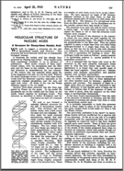
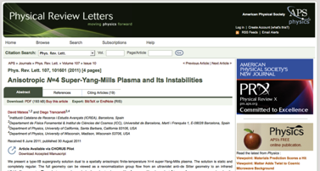
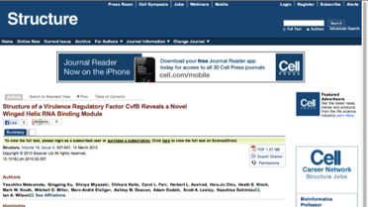
How CHORUS Works: Access
Embargo Period Expires
or Author/Funder Pays for Public Access
Version of Record
becomes publicly accessible
Accepted Author Manuscript
becomes publicly accessible

Slide 15

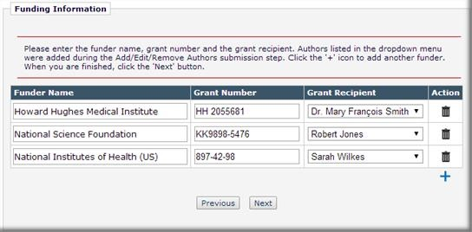




How CHORUS Works: Identification
…built into the author’s submission process
Publisher MTS
. . .

Slide 16




How CHORUS Works: Identification
…built into the author’s submission process
powered by

Slide 17





How CHORUS Works: Identification
…built into the author’s submission process
Publisher Host
. . .

Slide 18
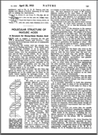


How CHORUS Works: Preservation
…use of existing, multiparty preservation strategy
Government maintained
or other
3rd-party dark archive

Slide 19

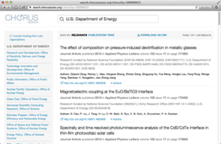
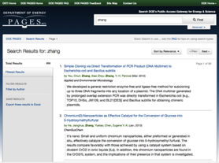


How CHORUS Works: Discovery
…by any existing search engine
Text and Data-Mining Services

Slide 20
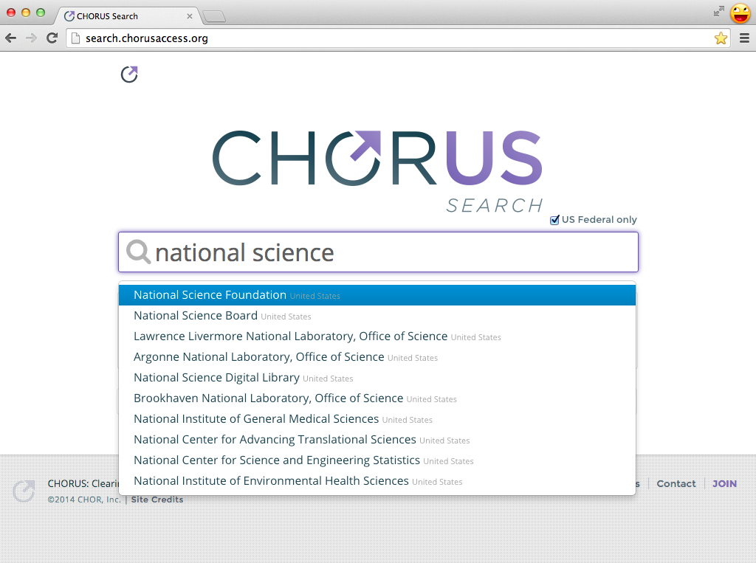
search.chorusaccess.org
powered by

Slide 21
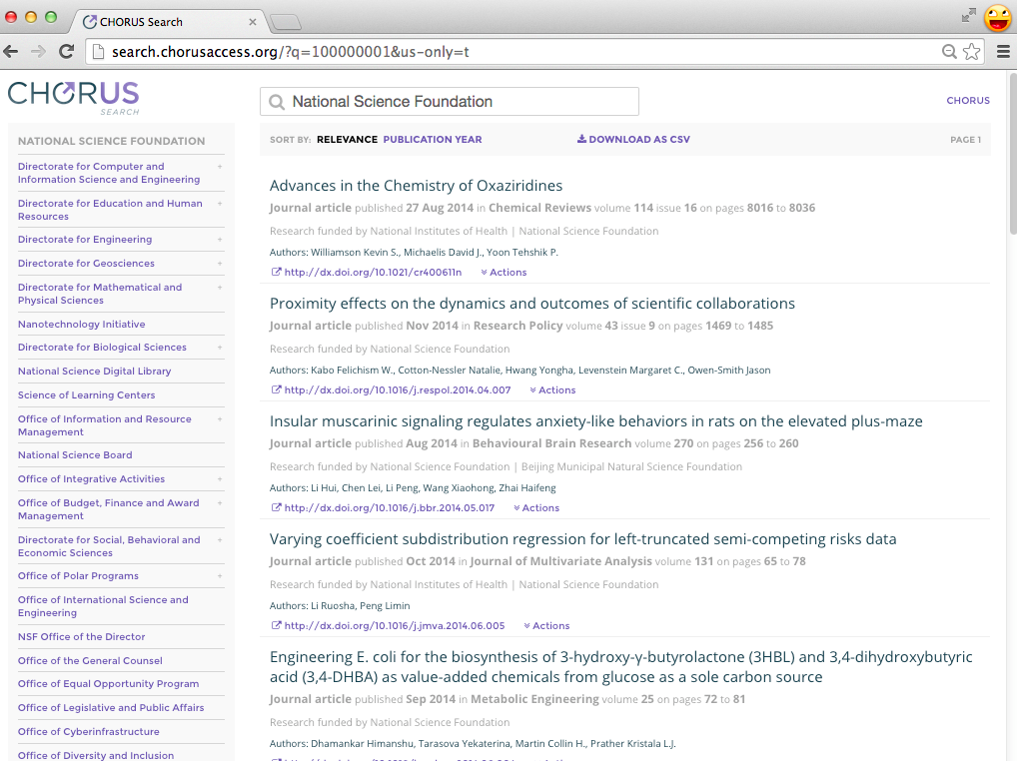
powered by

Slide 22
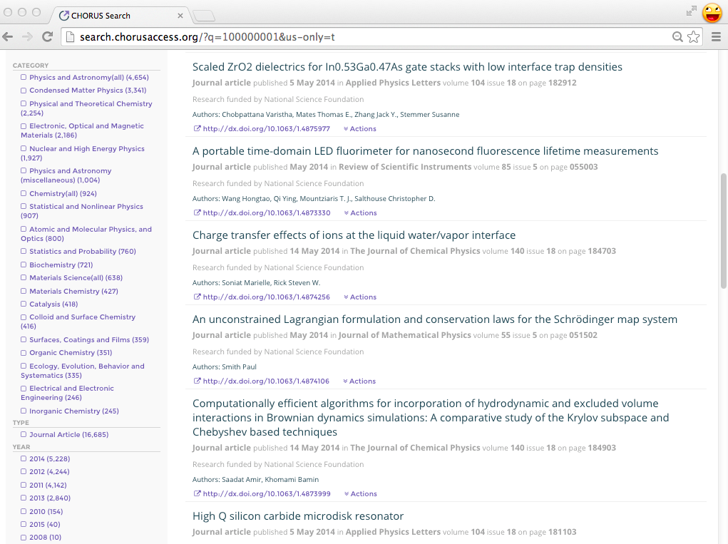
powered by

Slide 23
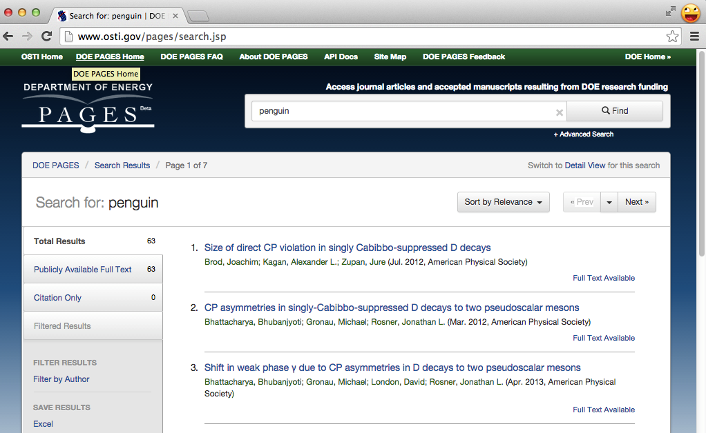
API Integration with Agency Portals

Slide 24
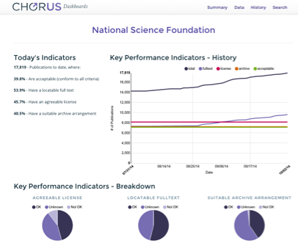
How CHORUS Works: Compliance
API and dashboards for monitoring and tracking publisher contributions to CHORUS
Government Agency Reports
Institution Reports
Publisher Reports
Live dashboard: dashboard.chorusaccess.org/nsf
Notes:
34,164 unique DOIs

Slide 25
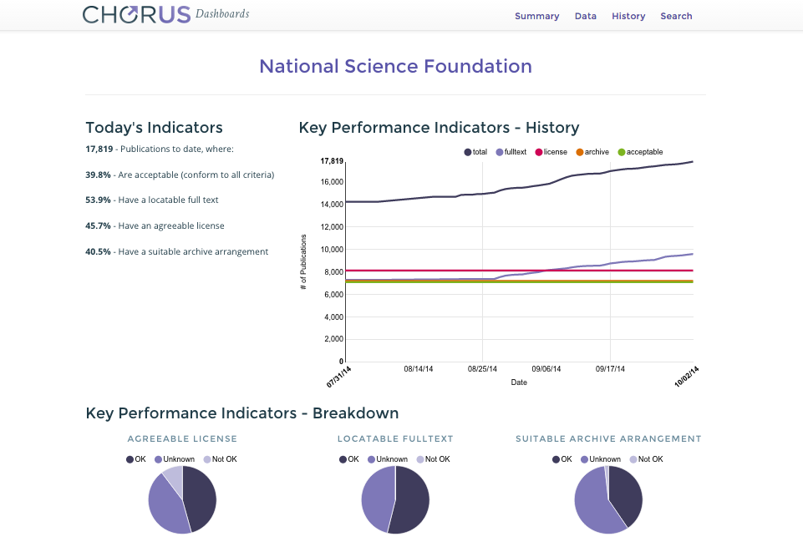
http://dashboard.chorusaccess.org/nsf
# Deposits
identifying
NSF
funding
# Records
having
agreeable
licenses
Content tested
for public
accessibility
# Deposits made
to dark archives
Notes:
Here’s a look at the dashboard set-up….

Slide 26
Total Articles Monitored
55,882
as of 12/11/14

Slide 27
Monitored Articles by US Agency

Slide 28
CHORUS Dataset Statistics
DOIs / Articles | Description
165,504 | unique CrossRef DOIs with FundRef IDs
55,882 | covered by CHORUS Dashboard
18,101 | offer public access
18,560 | offer no public access
19,221 | yet to be audited
As of 11 December 2014

Slide 29


CHORUS objective: interoperate with scholarly repositories and other systems providing access to scholarly articles
Agreed to work jointly on persistent identifiers, metrics, and notification system
Exploring more areas of collaboration
Active member of SHARE workflow working group
Notes:
SHARE and CHORUS met in July 2013 to discuss initiatives and explore areas of possible collaboration.
Both agreed to work jointly on persistent identifiers (DOIs) and metrics (dashboard could potentially be used to expose metrics from SHARE). Metrics to be determined, but most important message here is the potential collaboration and spirit of working together to solve problems...
And both agreed to follow up in next few months

Slide 30



Data
Value cross-linking data and articles
CHORUS infrastructure can link to data repositories
Unclear if there is one unified mechanism for data
and publications
Simplify procedures for researcher compliance and funding agency monitoring
Member RDA-WDS Publishing Data Services Working Group
CHORUS to use standard identifier schemes
Notes:
…
RDA-WDS Data-Pub Services Working Group

Slide 31

What Do Publishers Need To Do?
1
2
3
Identification
Tag content with CrossRef’s FundRef agency identifiers and your embargo metadata
Access
Provide public access to articles on your site posted with your reuse license terms
Preservation
Send content
to archiving service
JOIN
CHORUS
Discovery
Researchers can search and find your content
Compliance
Researchers can easily comply with their agencies
Notes:
So What Do Publishers Need to Do?
Tag content with CrossRef’s FundRef agency identifiers and your embargo metadata
Provide public access to articles on your site with your reuse license terms
Preserve your content with an archiving service
Join CHORUS and our services will enable researchers to discover and utilize your publicly accessible content and our compliance tools will show how researchers are in compliance with agency mandates

Slide 32
Membership Model
Publisher Members
<$5M Total Publishing Revenue: $1,000
≤$20m Total Publishing Revenue: $3,000
≤$50m Total Publishing Revenue: $5,000
≤$100m Total Publishing Revenue: $15,000
≤$200m Total Publishing Revenue: $25,000
≤$500m Total Publishing Revenue: $35,000
>$500m Total Publishing Revenue: $50,000
Affiliate Members
<$1m Gross Revenue: $5,000
≤$10m Gross Revenue: $15,000
>$10m Gross Revenue: $25,000
Agency/Funder Partners
No cost
Endorse and use services
Advisory status only
Academic Supporters
No cost
Advisory status only
Notes:
Publisher Members (majority)
Affiliate Members – non-publishers working in scholarly communications – Manuscript Tracking System vendors, hosting vendors, typesetters, other societies
Agencies can use our systems at no cost provided they sign a Partnership Agreement
Academics can show their support too.
Last year we needed around $1m in sponsorship to maintain operations; this year we will be seeking $500 from the scholarly publishers at Frankfurt.

Slide 33
Discover more information www.chorusaccess.org
Contact: Howard Ratner
hratner@chorusaccess.org
Follow us on Twitter: @chorusaccess
Identification • Discovery • Access • Preservation • Compliance

