Slide 1
ACS Publications and CHORUS
David Martinsen
Digital Strategy and Platform Development
ACS Publications Division
May 16, 2014

Slide 2
Article Versions

Slide 3
Which Version of the Article is part of CHORUS?
The OSTP Memo mentions both the Accepted Manuscript (AM) and the Version of Record (VoR) as acceptable for meeting public access requirements.
In order to help authors comply with the public access requirements, ACS provides several options to make the VoR publically available. These include:
  ACS AuthorChoice
  ACS AuthorChoice + 12
  License Options:
    Standard ACS AuthorChoice license
    CC-BY add-on
    CC-BY-NC-ND add-on

Slide 4
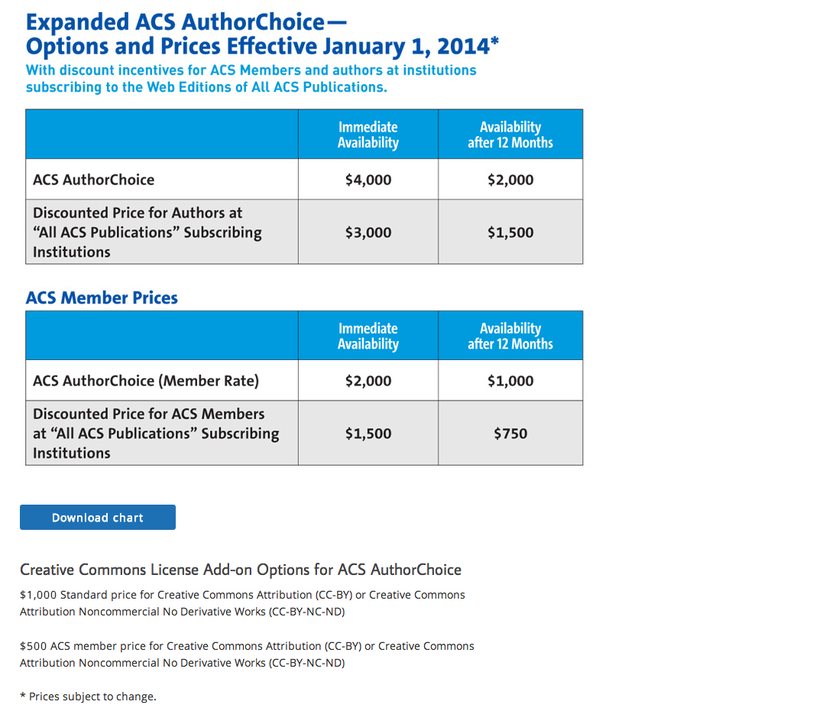

Slide 5
Capturing Funding Information

Slide 6
ACS Procedure for Capturing Funding Information
Authors optionally enter funding information at manuscript submission, using ParagonPlus, the ACS implementation of ScholarOne.
At revision time, ACS Cloud Services vendor checks Acknowledgment paragraph against author entry; the Acknowledgment paragraph is considered to be the authoritative information
If the author did not enter funding information, ACS Cloud Services adds the funding metadata

Slide 7
Experiences with Funding Agency Identification
27%
  Percentage of manuscripts with funding agencies identified during submission
15%
  Percentage of manuscripts where data entered by the author does not match the acknowledgment paragraph
1.5
  Average number of funding agencies per article*
11
  Maximum number of funding agencies in an article*
* based on published articles with FundRef metadata, April 22, 2014

Slide 9
CHORUS Metadata Deposits

Slide 10
FundRef and License Metadata Deposits
Atypon/Literatum is not yet ready to deposit funding and license metadata to CrossRef
ACS has developed its own metadata deposit workflow. These are deposited to CrossRef using partial deposit schema after the basic metadata have been deposited
FundRef deposits are now in production
License metadata is in testing, but we are awaiting the finalization of the licenseref spec before production

Slide 11
Workflow for FundRef/License Metadata Deposits to CrossRef
When an article is published, as JAM, as ASAP, or in a journal issue, basic metadata is deposited in CrossRef by Literatum
After each CrossRef deposit for each article, our journal publishing environment is triggered to send the funding and license metadata to CrossRef
Yet to come – deposit of dark archive metadata. The archive specification will be released in version 4.3.4 of the CrossRef Schema.

Slide 12
Example of XML for FundRef and License metadata deposits:
The Header
<?xml version='1.0' encoding='UTF-8'?>
<doi_batch xmlns:ns2=http://www.crossref.org/fundref.xsd
xmlns=http://www.crossref.org/doi_resources_schema/4.3.2
xmlns:ns3="http://www.crossref.org/AccessIndicators.xsd" version="4.3.2">
<head>
<doi_batch_id>bi401034q-969</doi_batch_id>
<depositor>
<name>American Chemical Society</name>
<email_address>cruser@acs.org</email_address>
</depositor>
</head>
<body>
<DOI RESOURCE BLOCK>
</body>
</doibatch>

Slide 13
Example of XML for FundRef and License metadata deposits:
The Resource Block - Part 1
<fundref_data>
<doi>10.1021/bi401034q</doi>
<ns2:program name="fundref">
<ns2:assertion name="fundgroup">
<ns2:assertion name="funder_name”>NIH Office of the Director
<ns2:assertion name="funder_identifier">10.13039/100000052</ns2:assertion>
</ns2:assertion>
<ns2:assertion name="award_number">PO1 DK096990</ns2:assertion>
</ns2:assertion>
<ns2:assertion name="fundgroup">
<ns2:assertion name="funder_name”>NIH Office of the Director
<ns2:assertion name="funder_identifier">10.13039/100000052</ns2:assertion>
</ns2:assertion>
<ns2:assertion name="award_number">U19 AI068021</ns2:assertion>
</ns2:assertion>
</ns2:program>
</fundref_data>

Slide 14
Example of XML for FundRef and License metadata deposits:
The Resource Block – Part 2
<lic_ref_data>
<doi>10.1021/bi401034q</doi>
<ns3:program name="AccessIndicators">
<ns3:license_ref>
http://pubs.acs.org/page/policy/authorchoice_termsofuse.html
</ns3:license_ref>
</ns3:program>
</lic_ref_data>

Slide 15
Fun with the CrossRef API

Slide 16
Fun with the CrossRef API
See documentation: https://github.com/CrossRef/rest-api-doc/blob/master/funder_kpi_api.md
Example: http://api.crossref.org/prefixes/10.1021/works?filter=has-funder:true&rows=1000&offset=0
  /prefixes/10.1021 = ACS
  /works = find all DOIs
  ?filter = set conditions on the API request
  has-funder:true = find only works with a funder id
  &rows = number of items to display
  &offset = starting point

Slide 17
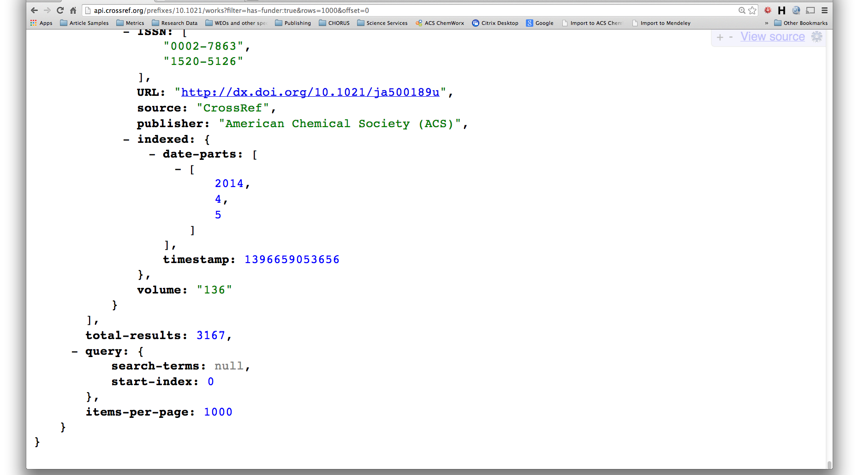
Fun with the CrossRef API

Slide 18
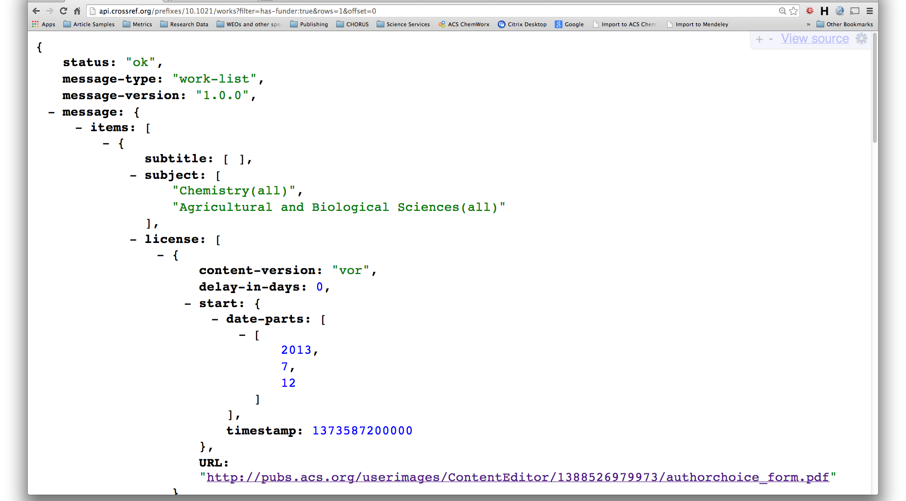
Fun with the CrossRef API

Slide 19
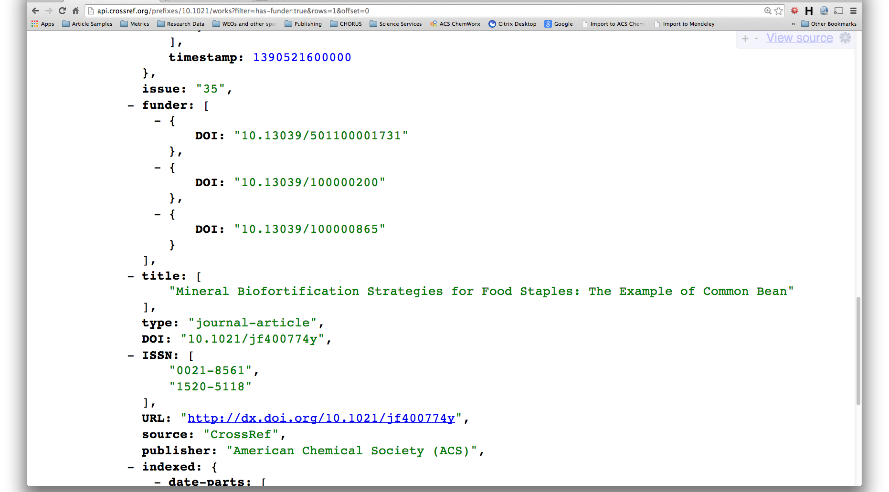
Fun with the CrossRef API

Slide 20
Acknowledgments
Global Editorial and Author Services
  Rose McCord – Sarah Tegen
  Charley Trowbridge
Journal Production and Manufacturing Operations
  Terri Lewandowski – Diane Needham
  – Rob O’Dell
IT
  Rise Schnizlein – Dan O’Brien
  Craig Asplund

Slide 21
ACS Publications and CHORUS
David Martinsen
Digital Strategy and Platform Development
ACS Publications Division
May 16, 2014

