Slide 1

Implementing CHORUS at AIP Publishing LLC
Evan Owens
CHORUS Webinar
16 May 2014
Notes:
To change the Event name, presenter and date:
Click “View”; select “Slide Master”
Click the Main Screen area to make the necessary changes.
Click “save”.
Reselect the “View tab”; Click on “Normal view” to exit Slide Master view.

Slide 2
Implementation Components for AIPP
Business Decision
  AM or VOR?
Collecting Metadata
  Peer Review System & CMS
Depositing Metadata
  CMS & CrossRef
Accessible Content
  CMS & Hosting Platform
Archiving Content
  CMS & Portico/CLOCKSS

Slide 3
FundRef Metadata Challenges
Collected from Authors via Peer Review System
Challenges:
FundRef MD versus Acknowledgments
  Verified by staff (new process)
Name problems
  Non-standard funder name forms, abbreviations
  Faux “new” funders
  True “new” funder names e.g. Chinese funders
Funder Hierarchy confusion
Author instructions make a difference!

Slide 4
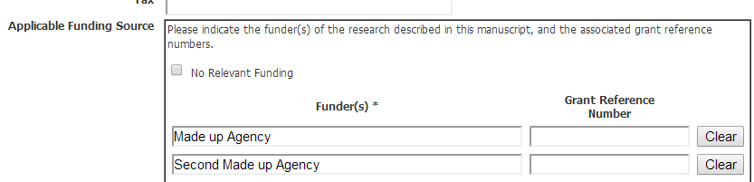
1st Version of an Entry Form UI

Slide 5
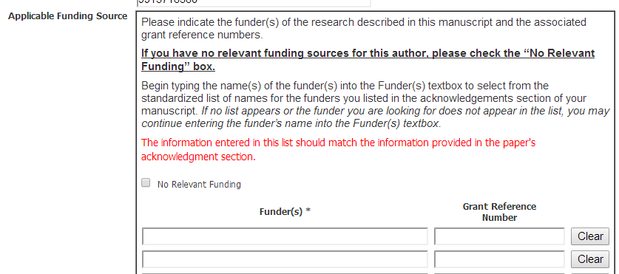
2nd Version: More Instructions

Slide 6
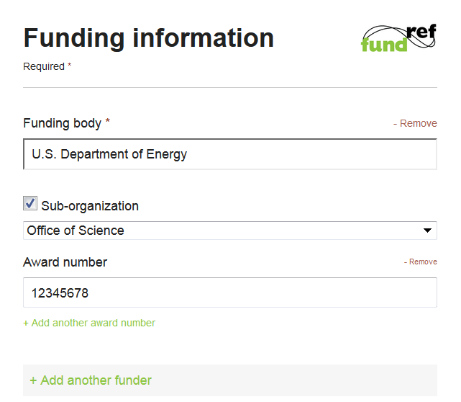
Labs.CrossRef.Org FundRef Widget

Slide 7
Managing the Metadata
Types of Metadata
  FundRef
  ORCID
  Licenses
  Archiving
  URLs
Storage Options
  In XML or in CMS…or both
Submission
  CrossRef / CrossMark

Slide 8
Content Access
Which Version?
  AM or VOR
  Gold Open Access is VOR
Hosting Systems tasks
  Content loading for AM
  Content display in UI for AM
  Access Control for AM or VOR

Slide 9
Content Archiving
Archiving Arrangements
  Portico
  CLOCKSS
Archiving Versions
  Already done for VOR!
  No support yet for AM

