Slide 1
Metadata
Best Practices
FundRef, license metadata & others
Notes:
A presentation on CrossRef metadata best practice, concentrating on new metadata components. These components are often more generic than is strictly necessary for CHORUS. There are also more of them than required by CHORUS at the moment, though that may change, and they have value by themselves anyway. They often overlap with other CrossRef and industry-wide initiatives. For example full-text links for TDM and for CHORUS aggregation.

Slide 2
Flow of Metadata
Dashboard & Search
Funder Registry
Publisher
Archive
Author (one way or another)
Publisher
Society
Funder
OA Publisher
SHARE
Researcher
Notes:
From a CHORUS and funder perspective, CrossRef and FundRef are providing value to funders by tracking funding and providing as much information as possible for publications that arise as a result of research funding.

Slide 3
Metadata Collection and Distribution
Collection
Determine funding of research
Determine licenses
Determine resources
Determine archive locations
Deposit with CrossRef
Distribution
Deposit with CrossRef
Metadata distribution via CrossRef API to CHORUS aggregation services, funding agencies, others
Notes:
Left side is the responsibility of content publishers and is what I will concentrate on.
Collection ends with a deposit to CrossRef. Distribution (and aggregation) starts with a deposit to CrossRef.
License, resources and archive arrangement are the *current* minimum requirement for CHORUS participation. Will discuss more pieces of metadata for CrossRef deposits too that we encourage deposit of, where available. However CHORUS requirements may change, for example, CHORUS is deciding now how to collect abstracts and whether this should be done via CrossRef metadata.
The more data collected the more value can be provided to funding agencies. I will explain how certain pieces of metadata may provide value to funding agencies.
Funding of an article may influence decision on licensing, which resources will be made available (am, vor) via full-text links in CrossRef metadata and where an article (and which version of an article) will be archived.

Slide 4
Collection and Distribution
Collection
Determine funding of research
Determine licenses
Determine resources
Determine archive locations
Deposit with CrossRef
Distribution
Deposit with CrossRef
Metadata distribution via CrossRef API to CHORUS aggregation services, funders, others
Notes:
Collection ends with a deposit to CrossRef. Distribution (and aggregation) starts with a deposit to CrossRef.

Slide 5
FundRef
Funding Agency DOIs
CrossRef
Metadata
Article DOIs
Award Numbers

Slide 6
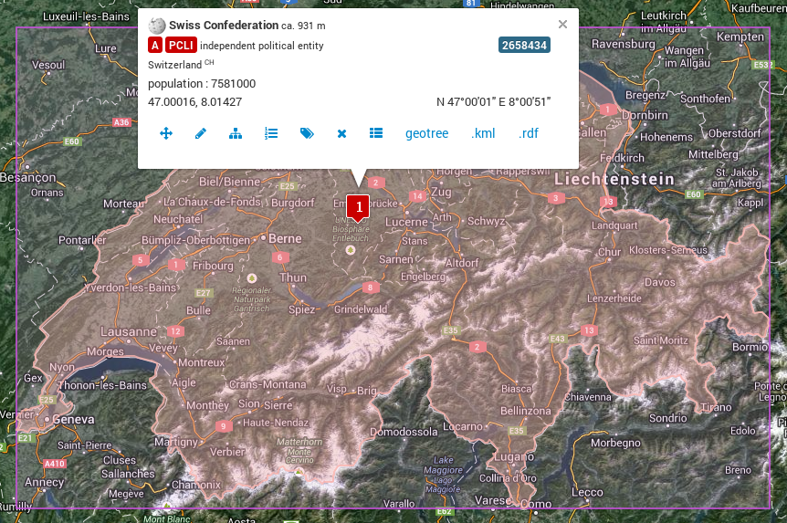
FundRef
<Concept rdf:about="./501100001711">
<inScheme rdf:resource="./SciValFunders"/>
<skosxl:prefLabel>
<skosxl:Label rdf:about="./Label-8212">
<skosxl:literalForm xml:lang="en">
Swiss National Science Foundation
</skosxl:literalForm>
</skosxl:Label>
</skosxl:prefLabel>
<svf:countryrdf:resource="http://sws.geonames.org/2658434/"/>
</Concept>
The FundRef funder registry
Around 6,000 funder organizations and sub-organizations
Incomplete, growing
International
Notes:
A reduced example funder record in the FundRef registry.
Elements not shown include alternate names, origin language names, organisation type and funder internal hierarchies.

Slide 7
FundRef
<program name="fundref">
<assertion name="fundgroup">
<assertion name="funder_name">
National Science Foundation
</assertion>
<assertion name="funder_identifier">
10.13039/100000001
</assertion>
<assertion name="award_number">
DE-SC0001091
</assertion>
</assertion>
</program>
Funding and award information in CrossRef metadata
Notes:
An example of a single funder record within a DOI record. This record is a funder record within CrossMark data, though funder data does not have to be included within CrossMark data.

Slide 8
FundRef Registry Updates
Deposit of unknown funders can result in updates to the FundRef funder registry
Updates to FundRef registry are published periodically
Notes:
There is a relationship between FundRef metadata deposits and the FundRef registry. Metadata deposits usually result in an update of the registry, unless the entry doesn’t contain enough info to locate the funder.
Currently published once a month but may become more infrequent as the registry becomes more complete.

Slide 9
FundRef Best Practice
Make best effort to collect and deposit funder DOIs
Reconcile funder names with the funder registry
FundRef reconciliation tool: http://labs.crossref.org/fundref-reconciliation-service
FundRef data entry example: http://labs.crossref.org/fundref/widget
Make best effort to collect and deposit award numbers
Notes:
Only legitimate reason for a FundRef record without a funder DOI is to record funding information for a funder that is not in the FundRef registry.
Funder DOIs are especially important for CHORUS. Funder records without funder DOIs will not be recorded in reporting tools. At least this will be the case until funder names missing from the registry are assigned a DOI and your records are updated retrospectively.
Best effort for data collection via author would be monitoring quality of data being entered, possibly working with technology partners to understand why data collection is going wrong and improve it, for example via user interface changes.
A reason why FundRef identifiers are important - names are not enough to uniquely identify funding organisations. There are at least four ‘National Science Foundations’ across the world:
Swiss National Science Foundation
U.S. National Science Foundation
National Science Foundation - Sri Lanka

Slide 10
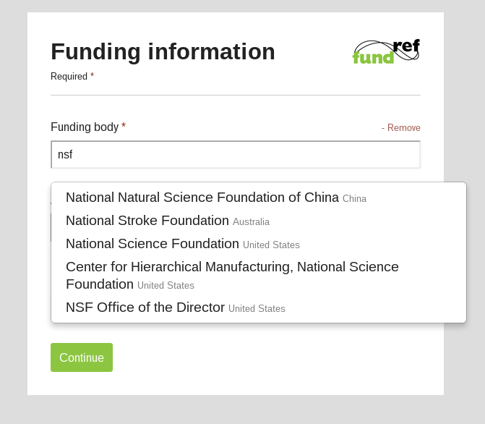
Collection of FundRef Data
Examine acknowledgements in manuscripts
Author entry at manuscript submission
Intramural funding for US federal agencies
and / or
Notes:
Examination of manuscripts may be used for backfiles, author entry for current publications.
When CrossRef has spoken to federal agencies they have indicated a desire to see intramural funding (that is, funding not through a grant but as a result of employment) recorded.
Therefore author entry at manuscript submission should probably include collection of author’s affiliation, or a clear indication that funding information should be entered for an author’s organisation if they work for a (federal) funder. Awaiting guidelines on this from the FundRef Advisory Group.
KM - The example above is likely an Austrian Univ that wouldn’t be expected to be credited for funding.

Slide 11
Using the Registry
Download and incorporate the registry
http://www.crossref.org/fundref
Query CrossRef’s API dynamically
http://api.crossref.org/funders?query=nsf
Notes:
The benefit of querying CrossRef dynamically is that the data will always be up-to-date using information from the latest registry file. CrossRef’s reconciliation tool using the CrossRef funder API to match names to funder DOIs.
Mainly for those developing their own submission system as well as technology vendors.
Query API will be under SLA so any technology vendor or publisher integrating into manuscript submission or peer review systems can work with guarantees on availability and uptime.

Slide 12
FundRef - Technology Integration
Vendor | Implemented
eJournalPress | Yes
ScholarOne | Yes
Aries | Rolling out
Atypon | Imminent
Publishing Technology | At least one implementation
Highwire | Release imminent
Notes:
This gives an indication that FundRef is being widely adopted by vendors. All that have spoken to CrossRef have said they already have or plan to integrate FundRef.
This is however specifically FundRef, not license metadata and the other new metadata components.

Slide 13
Collection and Distribution
Collection
Determine funding of research
Determine resources
Determine licenses
Determine archive locations
Deposit with CrossRef
Distribution
Deposit with CrossRef
Metadata distribution via CrossRef API to CHORUS aggregation services, funders, others
Notes:
Collection ends with a deposit to CrossRef. Distribution (and aggregation) starts with a deposit to CrossRef.

Slide 14
Resource Links
Federal funding agencies want to ensure that content is publicly available for reading, text-mining and indexing
Deep links to full-texts on publisher sites
No guarantee that the link is accessible
Notes:
Recording a link does not mean that the link is accessible to anyone in particular. Just that it exists.

Slide 15
Resource Links
Record a full-text link to a particular representation (mime type), JAV version (AM or VOR)
Possible to provide an ‘intended use’ hint
text-mining, syndication, search engine crawling, any
Notes:
An intended use hint indicates what the publisher intends the link to be used for. Options are text-mining, syndication, search engine crawling or any of those (no hint).

Slide 16
Resource Link Examples
Version of record XML intended for text mining, version of record PDF intended for access under a syndication arrangement:
<collection property=”text-mining”>
<resource content_type=”text/xml” content_version=”vor”>
http://publisher.com/full-text/vor/10.5555/12345678.xml
</resource>
</collection>
<collection property=”syndication”>
<resource content_type=”application/pdf” content_version=”vor”>
http://publisher.com/full-text/vor/10.5555/12345678.pdf
</resource>
</collection>

Slide 17
Resource Link Examples
Accepted manuscript PDF without an intended use hint:
<collection property=”any”>
<resource content_type=”application/pdf” content_version=”am”>
http://publisher.com/full-text/am/10.5555/12345678.pdf
</resource>
</collection>
Notes:
Say for the *same* DOI we also want to record that the accepted manuscript is available as a PDF, without any intended use hint.

Slide 18
Collection and Distribution
Collection
Determine funding of research
Determine resources
Determine licenses
Determine archive locations
Deposit with CrossRef
Distribution
Deposit with CrossRef
Metadata distribution via CrossRef API to CHORUS aggregation services, funders, others
Notes:
Collection ends with a deposit to CrossRef. Distribution (and aggregation) starts with a deposit to CrossRef.

Slide 19
License Metadata
Funding agencies may wish to report on the public availability of articles and data arising from research they fund
Embargo period length and license terms
Follows NISO access indicators proposal
<license_ref/> and <free-to-read/>
Different licenses for AM and VOR
Notes:
<license_ref> provides a link to a license for either the AM or VOR. free-to-read is a flag that indicates that content can be accessed and read for free. It is not make any assertion on re-use rights of the content.

Slide 20
License Link Best Practice
Create a web page and link for each version of a license
Use canonical URLs for community licenses such as CC licenses or the STM licenses
Optionally register DOIs for licenses
A ‘web page’ DOI type coming soon

Slide 21
License Metadata Example
A publisher wants to express that some articles within a hybrid journal are licensed under a proprietary license but, after an embargo period of one year, the articles become available to the public under CC-BY. Articles in the same journal that receive an APC are immediately made available to the public under CC-BY.
Notes:
This is probably a

Slide 22
Embargoed Articles
<doi_data><doi>10.5555/12345678</doi></doi_data>
<license_ref>
http://publisher.com/license/v1
</license_ref>
<license_ref start_date=”2015-04-28”>
http://creativecommons.org/licenses/by/3.0
</license_ref>
Notes:
License metadata is associated with and repeated for each particular article, not a whole journal.

Slide 23
Gold OA Articles
<doi_data><doi>10.5555/87654321</doi></doi_data>
<license_ref>
http://creativecommons.org/licenses/by/3.0
</license_ref>

Slide 24
Collection and Distribution
Collection
Determine funding of research
Determine license
Determine resources
Determine archive locations
Deposit with CrossRef
Distribution
Deposit with CrossRef
Metadata distribution via CrossRef API to CHORUS aggregation services, funders, others
Notes:
Collection ends with a deposit to CrossRef. Distribution (and aggregation) starts with a deposit to CrossRef.

Slide 25
Archive Locations
Depositing CrossRef member asserts the archive location(s) of content.
Not a guarantee of archiving but may be independently verified (by CHORUS, funders)
<archive_locations>
<archive name="DWT"/>
<archive name="Portico"/>
</archive_locations>
Notes:
Funders may want to ensure continued public access to content in the event of unavailability on a publisher site (e.g. CHORUS trigger event)
Archives will likely work with special trigger events for VORs reporting on federally funded research. This content would trigger in the event that it is not publicly accessible on the publisher’s site after an expected embargo period.
No guarantee for metadata consumers. They can accept the assertion, but there is no guarantee it is correct.
Archives could read CrossRef license and full-text link metadata to determine trigger events if they wanted automatic triggers.
The archive name list is a controlled vocabulary that will be updated as our members require it.

Slide 26
Collection and Distribution
Collection
Determine funding of research
Determine licenses
Determine resources
Determine archive locations
Deposit with CrossRef
Distribution
Deposit with CrossRef
Metadata distribution via CrossRef API to CHORUS aggregation services, funders, others
Notes:
Collection ends with a deposit to CrossRef. Distribution (and aggregation) starts with a deposit to CrossRef.

Slide 27
CrossRef Deposits - ORCIDs
Allow funding agencies to connect researchers to funding
CrossRef deposit metadata can include an ORCID for each contributor:
<contributor role=”author”>
<person_name>
<given_name>Josiah</given_name>
<surname>Carberry</surname>
<ORCID>http://orcid.org/0000-0002-1825-0097</ORCID>
</person_name>
</contributor>

Slide 28
CrossRef Deposits - Abstracts
Agencies may want to display abstracts in research portals
CrossRef metadata can accept a plain abstract text or a JATS <abstract> element

Slide 29
CrossRef Deposits - References
Has been possible to record under CrossRef Cited-By
Now possible to make references explicitly public
Give funding agencies insight into what other research is important for the research they fund
<reference_distribution_opts>
any
</reference_distribution_opts>

Slide 30
CrossRef Deposits
Resource (partial) deposits
FundRef, license and full-text links (and references) can be deposited separately
CrossMark or not CrossMark?
FundRef and license metadata
Recommended if you are planning to implement CrossMark
Notes:
Funding and licensing information can be placed inside CrossMark data, or can be left outside it. CrossMark participation is not required but is strongly encouraged. If you have not yet fully implemented CrossMark but are planning to you can still deposit FundRef and license metadata within CrossMark data.

Slide 31
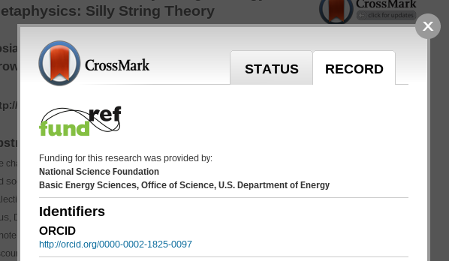
CrossMark Record Tab
Notes:
A reason to deposit in CrossMark is the standard display of funding information in the CrossMark record tab. CrossMark record tab will display FundRef funding information. Including license information is in the works.

Slide 32
CrossRef Deposits
All of the metadata discussed can be applied to datasets, proceedings, reports etc. that have CrossRef DOIs
Funding agencies would be able to track datasets as well as articles
Notes:
All of the metadata discussed can be applied to any type of output that can be given a DOI by CrossRef. This includes datasets, proceedings, reports, so on.
It is not that common for members to register CrossRef DOIs for datasets, but if more started to do so

Slide 33
CrossRef is agnostic...
about publishing business models
OA publishers can participate in FundRef, CrossRef Text and Data Mining, and deposit new forms of metadata
about funder geographical location
FundRef registry covers funders across the world
CrossRef encourages CHORUS participants to deposit all funding, not just US federal agencies
Notes:
CrossRef initiatives such as CrossRef Text and Data Mining are as applicable to OA publishers as they are subscription publishers.
FundRef is not just about federal agencies and CHORUS, it covers funders across the world. Publishers can deposit global funding information for their content.
CrossRef encourages CHORUS participants to supply FundRef data not just for US federal funders but all funding information possible. A full implementation of FundRef. This may have value for funding agencies because they would be able to
tell where their funding overlaps with that of other agencies.

Slide 34
Implementation Recap
Determine funding of research output
Implement FundRef data collection on manuscript submission, or integrate into production phase
Select license and full-text links
Create license pages
Optionally register DOIs for licenses
Deposit with CrossRef
Include funder DOIs, award numbers, license and full-text links, archive locations, (abstracts, ORCIDs, public references) in CrossRef metadata deposits
Notes:
A CrossRef and FundRef perspective on implementation of CHORUS.

Slide 35
CrossRef Metadata Links
Funder DOIs
License URLs
Resource URLs
Article DOIs
Award Numbers
Contributor ORCIDs
Notes:
When considering CrossRef metadata as a whole, the relationships between identifiers are even more interesting than when considering FundRef alone.

Slide 36
Further Reading
FundRef website
http://www.crossref.org/fundref
Geoff Bilder’s Best Practice Guide for Funder KPIs
http://api.crossref.org/help/bestpractice
Evan Owens’ CHORUS Implementation Guide

