Slide 1
CHORUS and FundRef
Implementation at Elsevier
Chris Shillum
VP Product Management, Platform and Content, Elsevier
CHORUS Implementation Workshop, 28 April 2014

Slide 2
Topics
FundRef Taxonomy Update Workflow
Gathering and Validating Article Funding Info
Author Manuscript User Experience

Slide 3
FundRef Taxonomy Update Workflow

Slide 4
Monthly Updates of FundRef Taxonomy
Elsevier | CrossRef
Funding Body record
FundRef Registry
Funding Body record
Elsevier Funder Taxonomy
Funding Body record
Funding Body Record
Compilation of all Funding Bodies into SKOS file
Assignment and Registration of DOIs (by CrossRef)
Metadata captured
URI
Full organization name
Synonyms
Abbreviations
Website URL
Relationships (inc. Hierarchial) with other organizations
Contact Details
Country
State
Type of organization (government, company, foundation, etc.)
Description of organization

Slide 5
Funding Body Taxonomy Update Workflow
New Funding Body Record
CrossRef
Elsevier Journal Articles
Gather Candidate Funding Bodies
Harvest Funding Body Metadata
Scopus Records
Decline Notification
Funder Websites
Candidates are new (non-matched) funding bodies encountered by FundRef participants or in Elsevier internal workflows | Sources used: Funder websites, Ringgold Internal databases | Records created for genuinely new funding bodies Duplicates may add synonym to existing record If organization does not appear genuine, decline notice sent

Slide 6
Gathering and Validating Article Funding Info

Slide 7
Manuscript Workflow Changes
Manuscript Submission
Author is asked to confirm all funding organizations are mentioned in the article
XML Creation
Supplier tags funding organizations and grant numbers in XML file
Proofing
Author is requested to verify funding organizations are correctly captured
Typically in the Acknowledgment section
Tagged funding information is extracted from XML and listed on author query form
FundRef IDs of “known” funding bodies are included in this tagging

Slide 8
Challenges when Capturing Funding Body Information
Dozens of ways to misspell or abbreviate organization names
  U.S. DOE; US DOE; DOE; Department of Energy; Dept. of Energy; United States Department of Energy
  National Institute of Health (singular) versus correct National Institutes of Health
Duplicate abbreviations
  AAA can stand for American Accounting Association; American Anthropology Association; American Association of Anatomists; American Academy of Audiology
Same organization name in multiple countries
  A National Science Foundation exists in the US, Denmark, Iran, Georgia (the country), Switzerland, etc.
Organizations emerge, get renamed, are merged with other organizations, create spin-offs, get split, cease to exist
  American Dietetic Association ► Academy of Nutrition and Dietetics
  Lance Armstrong Foundation ► Livestrong Foundation
Understanding how funding is organised internationlly Requires local expertise to assess relationships, help to translate organization names
  Natural Science Foundation of Jiangsu Province
  Jiangsu Provincial Natural Science Foundation

Slide 9
CHORUS / FundRef Development Schedule
 | Funder Taxonomy Workflow | Article Funding Info Workflow
2008 | “Grant Warehouse” to capture funding organizations and grants released – initially only US organizations Workflow to asses funder validity and harvest metadata created
2011 | UK, Canadian, Australian and EU organizations added to Grant Warehouse
2013 | Asian and ROW organizations started being added to Grant Warehouse SKOS Conversion Routines developed Monthly submission of FB taxonomy to CrossRef started
June 2014 |  | New funding info tagging workflow deployed
July 2014 |  | Submissions of funding info to CrossRef as part of DOI registration to start
Q3/Q4 2014 |  | Capability to display of AAM in ScienceDirect User Interface
July 2015 |  | First post-embargo AAM publically available (assuming 12-month embargo)

Slide 10
Author Manuscript User Experience

Slide 11
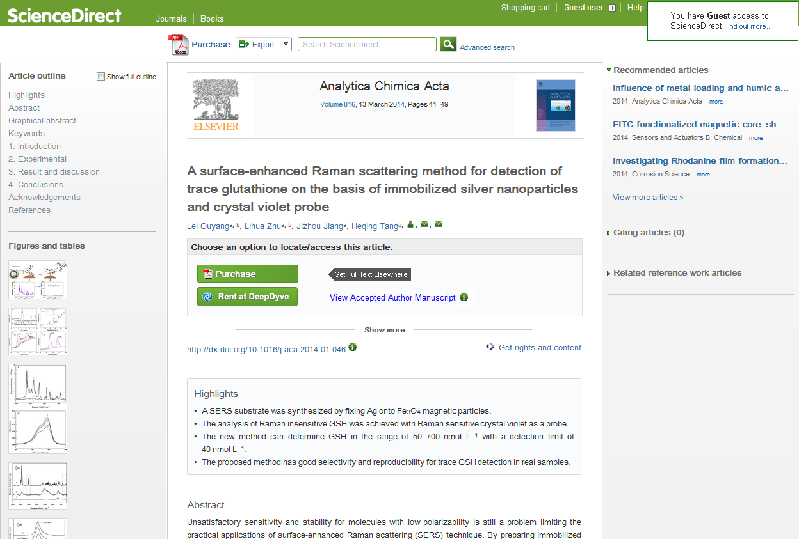
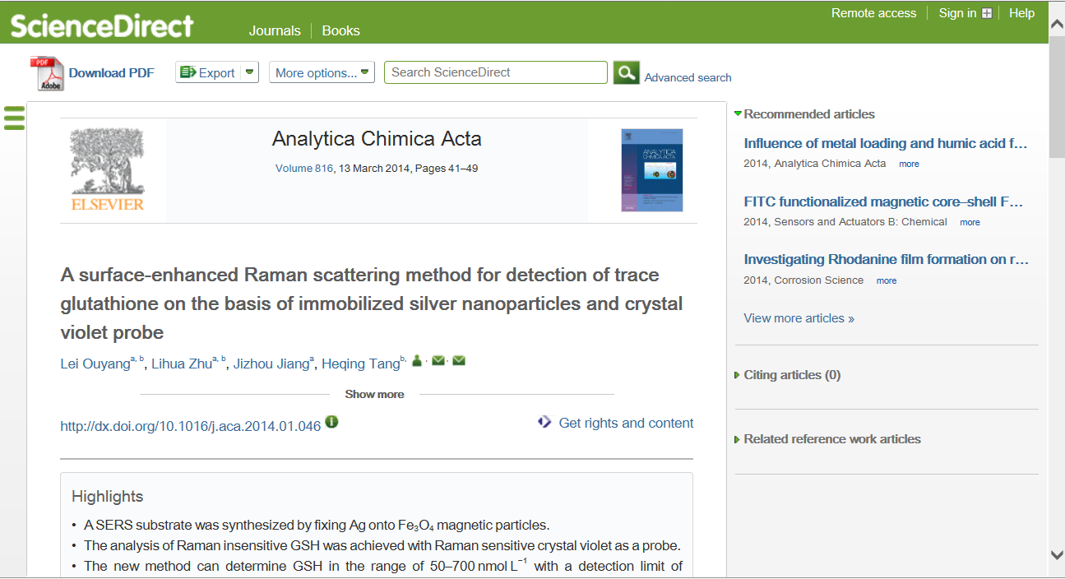

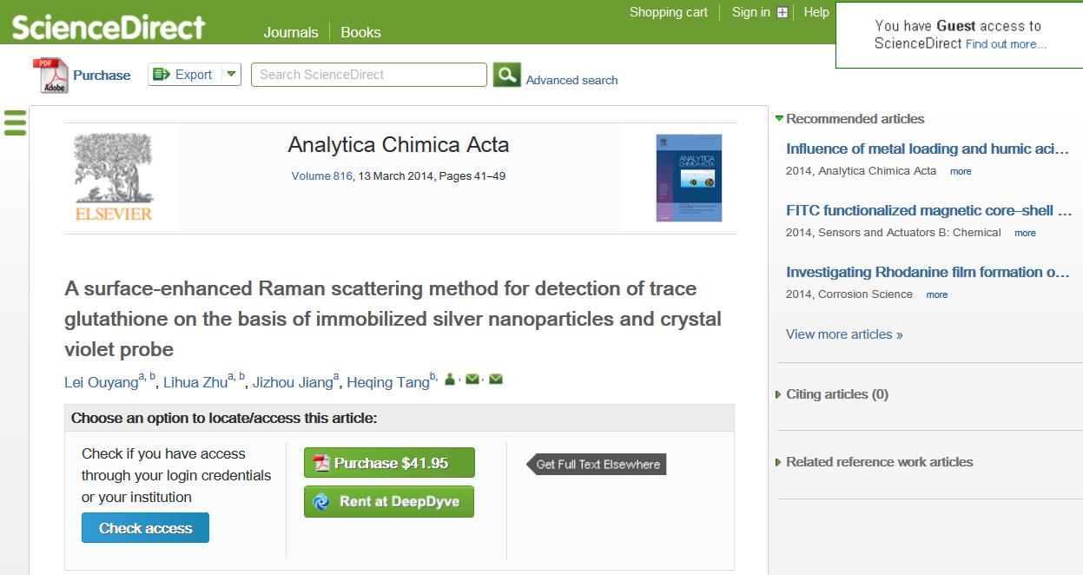
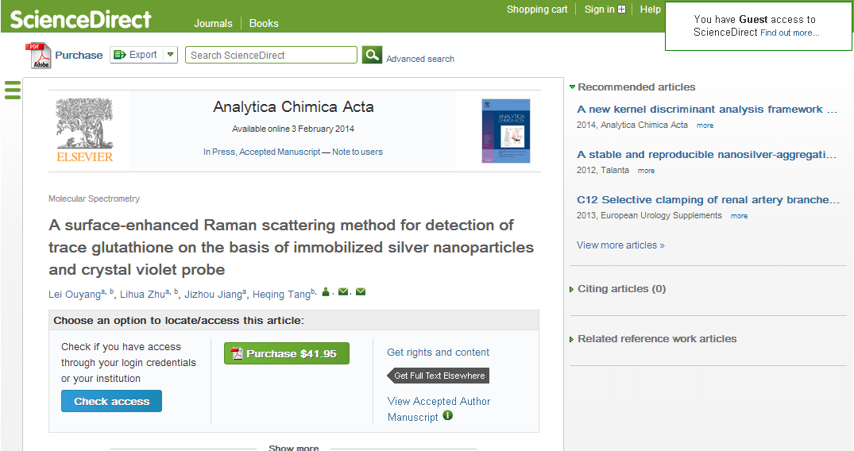
Best Available Version Logic
Subscribed Access
Gold OA Article
Open Archive Article
Full text HTML VoR
Non subscribed article
CHORUS article pre embargo
Current Abstract Page
CHORUS article post embargo
New Abstract Page with link to AAM

Slide 12
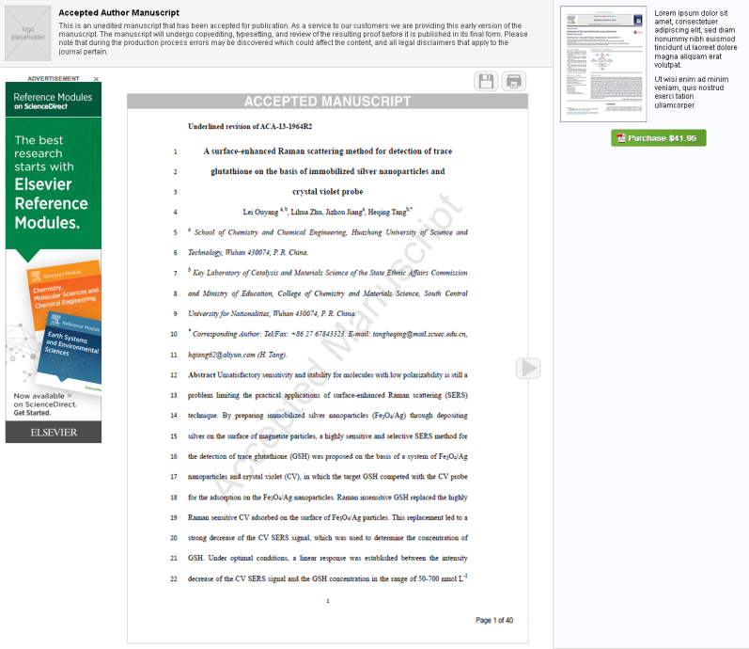
Public Access to Accepted Author Manuscript
Public access offering differentiated from VoR, potentially as follows:
  Page viewer format optimised for main use case, i.e. reading
  Without enhanced features recommendations/ linked references/ citations/author links
  Warnings regarding “early versions”
  Clear option to download final VoR
Draft under
consideration

Slide 13
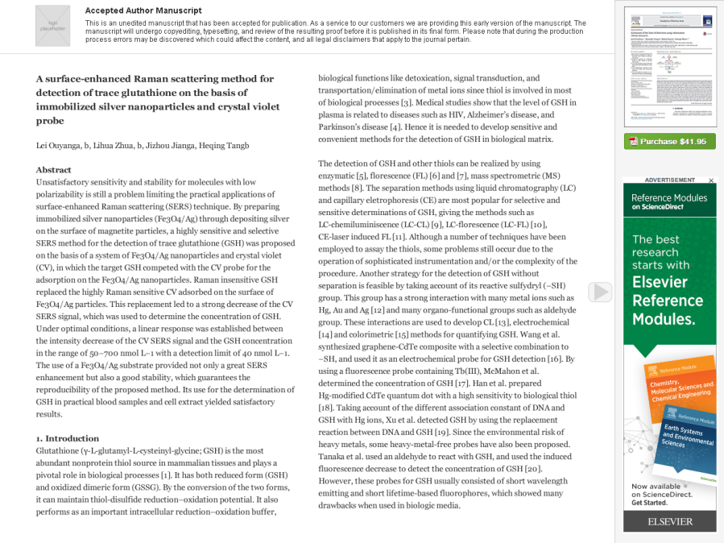
Testing Various User Experiences
Draft under
consideration

Slide 14


Questions?
c.shillum@elsevier.com
@cshillum

