Slide 1

The CHORUS Pilot
An Agency Perspective
CHORUS Implementation Webinar
May 16, 2014
Mark Martin
Assistant Director, Office of Scientific and Technical Information
Office of Science
U.S. Department of Energy

Slide 2
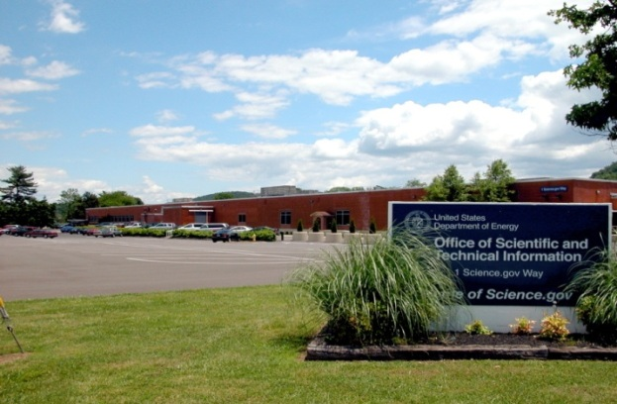
What Is OSTI?
OSTI has the corporate responsibility for ensuring access to DOE R&D results.
Energy Policy Act of 2005
“The Secretary, through the Office of Scientific and Technical Information, shall maintain within the Department publicly available collections of scientific and technical information resulting from research, development, demonstration, and commercial applications activities supported by the Department.”

Slide 3
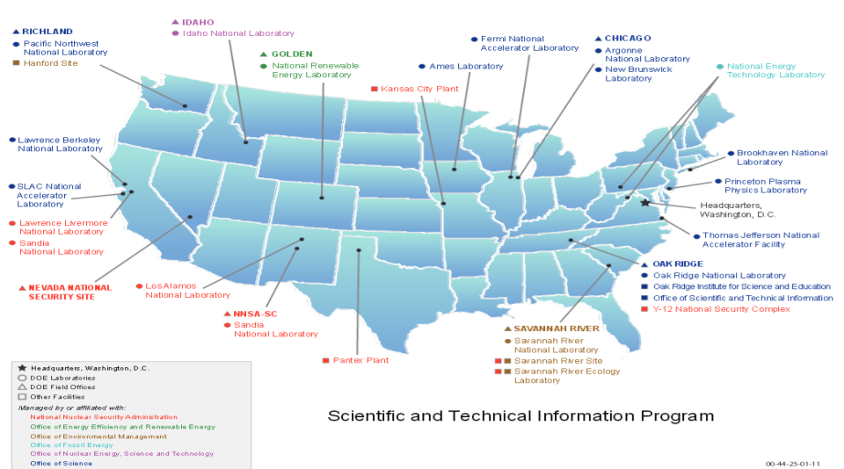
How Do We Do It?
DOE STI Program (STIP)
OSTI coordinates with POCs across the complex.
DOE R&D results are:
collected from DOE offices, labs, and facilities, as well
as university grantees and financial assistance awardees;
preserved for re-use; and
made accessible via multiple web outlets.
DOE-affiliated journal articles are part of the OSTI R&D information flow

Slide 4
2013 OSTP Memo – Federal Agencies
Need to Increase Access to Research Results
  Released Feb 22, 2013 www.whitehouse.gov/sites/default/files/microsites/ostp/ostp_public_access_memo_2013.pdf
  …ensuring that, to the greatest extent…the direct results of federally funded research are made available and useful. “Such results include peer-reviewed publications and digital data.”
  Applies to agencies with >$100 million in R&D expenditures.
  Recognizes publishers’ services are essential for ensuring the high quality and integrity of scholarly pubs, critical to continue.

Slide 5
Criteria for a DOE Public Access Model
Enables LONG-TERM free access by the public to the “best available version” of peer-reviewed scientific and technical information sponsored by DOE.
Enables single search box of all DOE-sponsored research literature without requiring that articles be in a centralized collection.
Maintains a comprehensive metadata collection in order for the agency to fully account for its scholarly output.
Preserves the freedom of researchers to promote and disseminate their research, i.e., preserves researchers’ choice in selecting the journal to which they wish to submit manuscripts.
Recognizes the value added by publishers in providing high-quality scholarly communications and research tools and accommodates flexible publisher business models.
Promotes the Version of Record for each article.
Minimizes cost to DOE.
Encourages coordination and collaboration among agencies, institutions, and the publishing community.
The proposed DOE public access gateway meets these criteria.

Slide 6

The Proposed Public Access Gateway
Our planned model is a natural evolution and extension of ongoing public dissemination capabilities and systems…our Scientific and Technical Information Program (STIP).
Built with proven software and architecture
Leveraging existing ingest and dissemination tools
With a twist…

Slide 7

Publishers’ Contribution to Agencies’ Public Access Obligations
The proposed DOE model for public access would leverage CHORUS and FundRef.
The CHORUS collaboration enables our ‘Best Available Version’ concept.
7

Slide 8

The Pilot Experience…Collaboration
Collegial
A partnership between participants
Responsive
An ongoing interchange
of information to achieve
standardization
Diverse
An alliance of colleagues from different organizations with distinct viewpoints
8

Slide 9
Technical Approach and Challenges
The Pilot Experience… Challenges
<license_ref/>
Indicates the license under which the record is made available.
<resources/>
Provides a link to the full text for indexing.

Slide 10
The Pilot Experience…Success
Major Milestone Achieved Nov. 8, 2013:
The proposed DOE public access gateway linked to content via CHORUS, all full-text searchable.
APS was the only publisher with content successfully processed on November 8.
AIPP and IEEE have subsequently been added.
We are continuing to work with other CHORUS Pilot participants.
10

Slide 11
The Pilot Experience…Future
Hope to see FundRef usage spread throughout the publishing community, and the number of CHORUS participating publishers continue to increase, leading to a corresponding increase in CHORUS content related to DOE.
Along with distributed access to accepted manuscripts obtained through the existing DOE STIP infrastructure, CHORUS content in DOE’s proposed public access solution will complete the “best available version” concept.
11

