Slide 1
A Solution for Public Access
CHORUS Implementation Workshop #2
Howard Ratner, Executive Director, CHOR, Inc.
hratner@chorusaccess.org
www.chorusaccess.org
Identification • Discovery • Access • Preservation • Compliance

Slide 2
Open Access Funder Mandates

Slide 3
Increasing Access to the Results of Federally Funded Scientific Research
All federal agencies funding $100M or more annually in extramural research must develop public access policies
Free public access to peer-reviewed research articles (guideline: 12-month embargo, adapted to agency/discipline need)
Ensure interoperability and long-term stewardship
Need policies on both articles and data
Issued February 2013
Draft plans submitted
Now out for revision

Slide 4
A broad coalition of scholarly publishers formed to develop, implement and steward a partnership with the federal research funders for providing public access to the peer-reviewed publications that report on federally funded research.
Evolved from an ad-hoc group of publishers who initiated partnership discussions with several agencies in Spring 2011
Incorporated as a not-for-profit entity – CHOR, Inc. – on October 1, 2013
US IRS 501(c)(3) tax-exempt status pending
100+ signatories and growing
Exploring international partnerships
Already in pilot!
4

Slide 5
PLUS OVER 100 SIGNATORIES

Slide 6
Supporting Organizations (April 2014)
AAAS
Acoustical Society of America
ACSESS
American Association of Anatomists
American Association for Cancer Research
American Association of Physicists in Medicine
American Association of Physics Teachers
American Astronomical Society
American Chemical Society
American Crystallographic Association, Inc.
American College of Chest Physicians
American College of Physicians
American Dental Association
American Diabetes Association
American Geophysical Union
American Inst of Aeronautics and Astronautics
American Institute of Biological Sciences
American Institute of Chemical Engineers
American Institute of Physics
American Mathematical Society
American Meteorological Society
American Medical Association
American Nuclear Society
American Physical Society
American Physiological Society
American Psychiatric Publishing
American Psychological Association
American Society for Biochemistry and Molecular Biology
American Soc of Agricultural & Biological Engineers
American Society of Agronomy
American Society of Civil Engineers
American Society of Mechanical Engineers
American Society for Microbiology
American Society of Neuroradiology
American Society of Plant Biologists
American Speech-Language-Hearing Association
Asociacon Columbiana de Infectologia
Assoc for Computing Machinery (ACM)
Assoc for Research in Vision and Ophthalmology
AVS: Science & Technology of Materials, Interfaces and Processing
Biophysical Society
Bioscientifica
Botanical Society of America
British Editorial Society of Bone & Joint Surgery
BMJ
Cambridge University Press
Columbia University Press
The Company of Biologists
Crop Science Society of America
Dove Press
Duke University Press
Ecological Society of America
ECS - The Electrochemical Society
EDP Sciences
Elsevier
Emerald Group Publishing Limited
The Endocrine Society
Entomological Society of America
European Respiratory Society
Fabricators and Manufacturers Association, International
Genetics Society of America
GeoScienceWorld
Human Factors and Ergonomics Society
IEEE
iMedPub. Internet Medical Publishing
INFORMS
Institute of Physics Publishing
Institution of Engineering and Technology (IET)
Journal of Bone and Joint Surgery
Journal of Infection in Developing Countries
Journal of Rehabilitation Research and Dev
Lynne Rienner Publishers, Inc.
Materials Research Society
McGraw-Hill
Mycological Society of America
Nature Publishing Group
New England Journal of Medicine
The Optical Society
Oxford University Press
The Physiological Society
Revista Medica de Risarlda
The Royal College of Psychiatrists
The Royal Society
Royal Society of Chemistry
Sage Publications
Society for the Advancement of Materials on Process Engineering
Society for the Study of Reproduction
Soil Science
Society of America
Springer Science+Business Media LLC
Taylor & Francis
Thieme Publishers
University of Chicago Press
John Wiley & Sons
Wolters Kluwer Medical Research
Plus 11 more service providers & organizations
Notes:
List of signatories. New members joining every week.

Slide 7
US Office of Science and Technology Policy (OSTP) + CHORUS
OSTP Requirement
Free public access to peer-reviewed research articles (guideline: 12 month embargo adapted to agency/discipline needs)
Optimize search, archival, and dissemination features to encourage innovation
Ensure interoperability and long-term stewardship
Policies on public data also called for
Develop plans in consultation with stakeholders
CHORUS Services
Publishers provide free public access to best available version (accepted author manuscript or Version of Record) post embargo or if paid by article processing charge
CHORUS API enables content syndication and search services
CHORUS enables archiving via CLOCKSS, Portico, and other government sponsored archives
CHORUS infrastructure can link to data repositories when available
CHORUS is ready to work with agencies
7

Slide 8
How Does CHORUS Help?
Identification
Discovery
Alan
Agency
Rachel
Researcher
Compliance
Preservation
Access
Lottie
Librarian
Peter
Public
Penny
Publisher

Slide 9
Preserve Agency Funds for Research!
Builds on existing infrastructure of the scholarly community
9

Slide 10
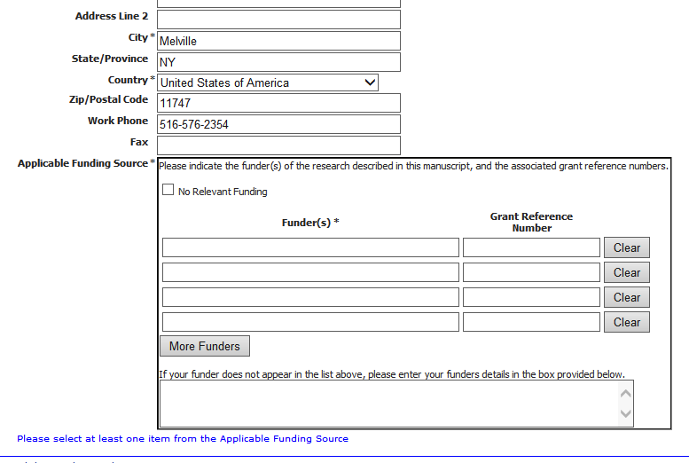
How CHORUS Works: Identification
…built into the author’s submission process

Slide 11
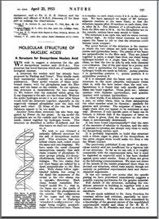
How CHORUS Works: Preservation
…use of existing, multiparty preservation strategy
Government maintained or other 3rd-party dark archive

Slide 12
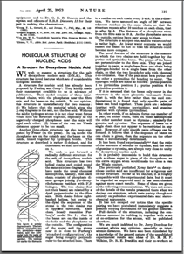
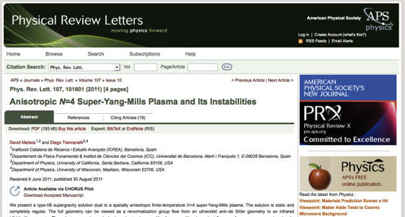
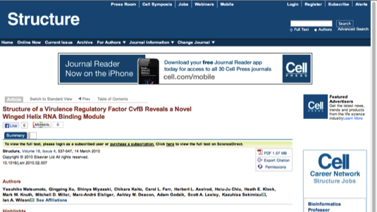
How CHORUS Works: Access
Embargo Period Expires
or Author/Funder Pays for Public Access
Version of Record
becomes publicly accessible
Accepted Author Manuscript
becomes publicly accessible

Slide 13
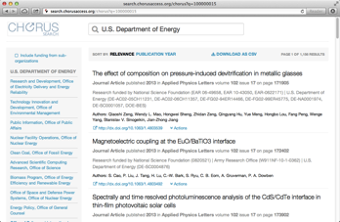
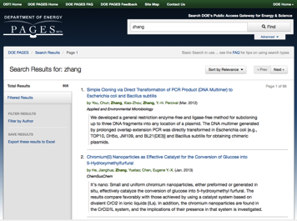
How CHORUS Works: Discovery
…by any existing search engine
Text and Data-Mining Services

Slide 14
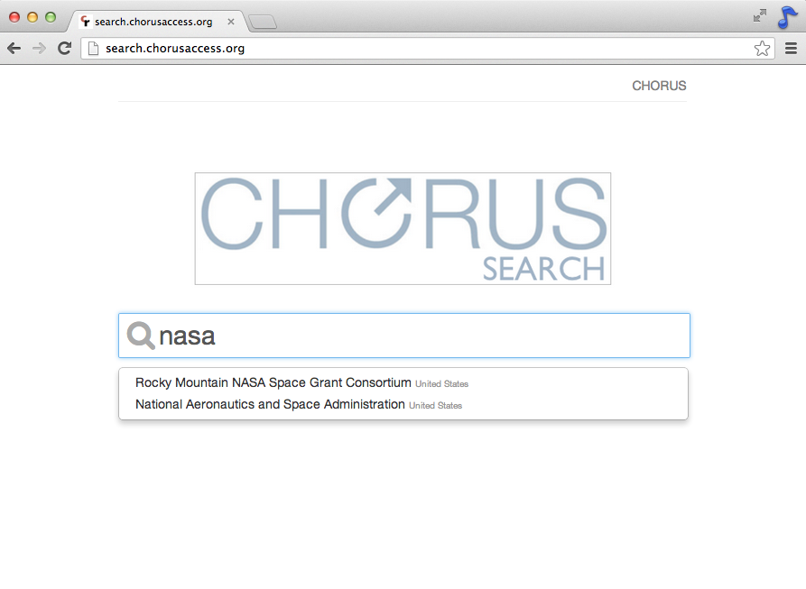
search.chorusaccess.org
powered by

Slide 15
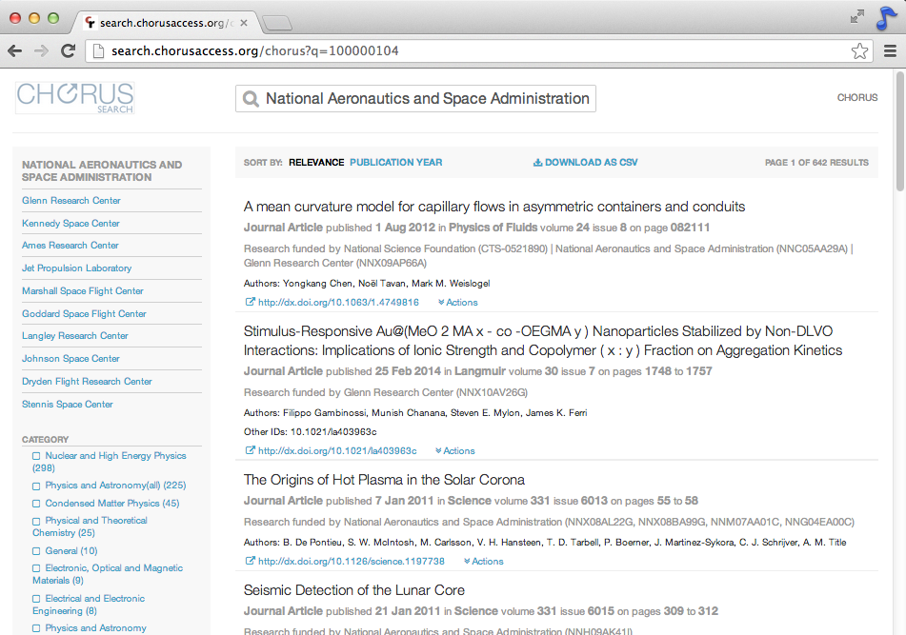
powered by

Slide 16
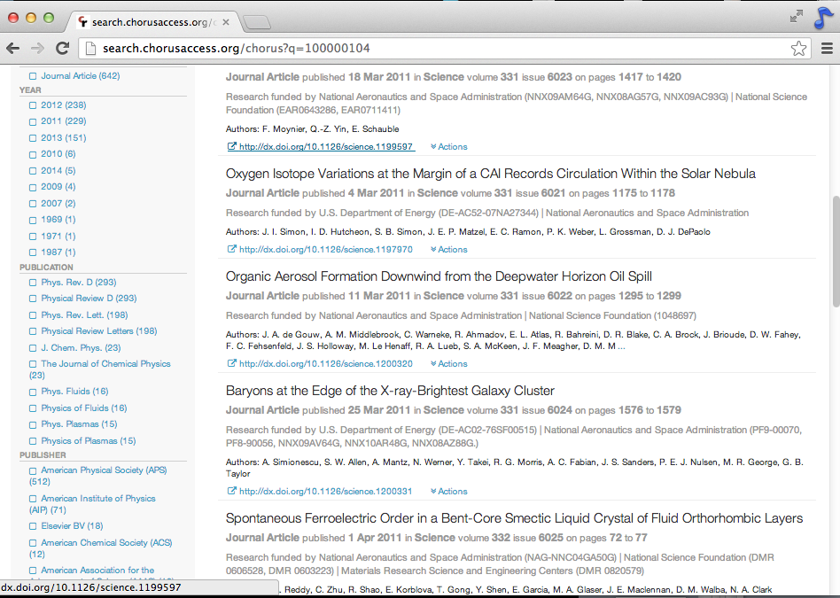
powered by

Slide 17
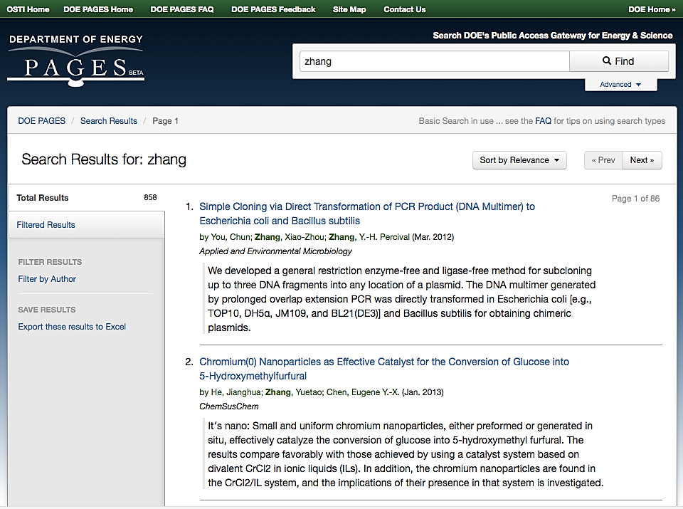
API Integration with Agency Portals

Slide 18
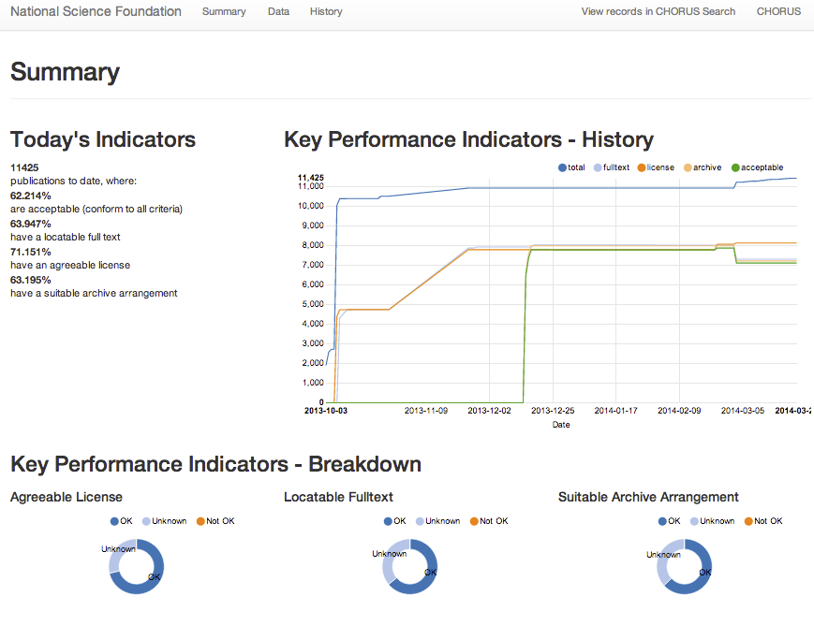
How CHORUS Works: Compliance
API and dashboards for monitoring and tracking publisher contributions to CHORUS
Government Agency Reports
Institution Reports
Publisher Reports
Live dashboard: dashboard.chorusaccess.org/nsf

Slide 19
http://dashboard.chorusaccess.org/nsf
# Deposits
identifying
NSF
funding
# Records
having
agreeable
licenses
Content tested for public
accessibility
# Deposits made to dark archives
Notes:
Here’s a look at the dashboard set-up….

Slide 20
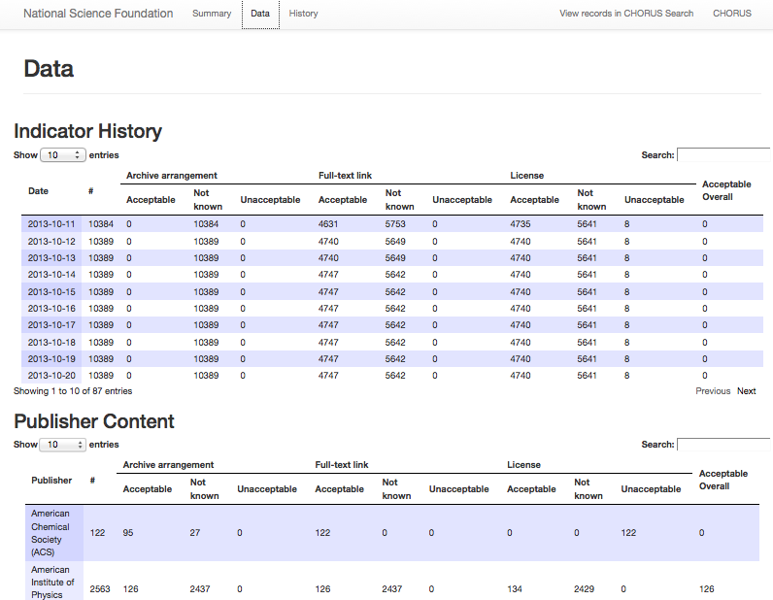

Slide 21
Ramp up
Feb –
June 2013
Proof of
Concept
Delivered 30 Aug
Pilot Tech
Build
Delivered 30 Sept
Pilot
Phase 1
30 Sept -
31 Dec
2013
Pilot
Phase 2
Jan – July 2014
Production
July 2014
AAP Startup Funding
Appointment of Howard Ratner, Director of Development (July)
Incorporation
of CHOR, Inc.
1 Oct 2013
Fundraising
Appointment of Howard Ratner, Executive Director (January)
Notes:
So, where are we now and where are we heading……
Have a look at the timeline.
Fundraising has already taken place to make the service sustainable in the near term, and there is a growing commitment from the publishing community for a long term commitment as the service gains support from more publishers over time.

Slide 22
CHORUS aspires to be inclusive and interoperate with scholarly repositories and other systems providing access to scholarly articles
Agreed to work jointly on persistent identifiers, metrics, and notification system
Continuing to explore more areas of collaboration
Member of SHARE workflow working group
Notes:
SHARE and CHORUS met in July 2013 to discuss initiatives and explore areas of possible collaboration. I believe this meeting included Judy from ARL and Howard from CHORUS.
Both agreed to work jointly on persistent identifiers (DOIs) and metrics (dashboard could potentially be used to expose metrics from SHARE). Metrics to be determined, but most important message here is the potential collaboration and spirit of working together to solve problems...
And both agreed to follow up in next few months

Slide 23
Data?
Unclear whether there is one unified mechanism for data and publications
Value in linking data to the papers it supports
Simplify procedures for researcher compliance and funding agency monitoring
CHORUS infrastructure can link to data repositories when available
CHORUS will use standard identifier schemes

Slide 24
What Do Publishers Need To Do?
Become a signatory of CHORUS
Become a member of CrossRef
Sign up for FundRef as part of CrossRef membership
Submit agency-related data to CrossRef/FundRef for all new content
Send public access content reuse license and embargo metadata to CrossRef
Deposit full text URIs with CrossRef
Sign CHORUS Agreement (Pilot or Membership)
Send relevant content to archiving service
Notes:
So What Do Publishers Need to Do?
Become a signatory of CHORUS
Become a member of CrossRef
Sign up for FundRef as part of CrossRef membership
Submit Agency Related data to FundRef for all new content
Send public access content reuse License and Embargo metadata to CrossRef
Deposit full text URIs with CrossRef Prospect
Sign CHORUS Pilot Agreement
Send relevant content to archiving service
Sign CHORUS Pilot Agreement
Send relevant content to a host archive service

Slide 25
Simple Guide to Implementing CHORUS
What Do Publishers Need To Do?
Collect funder information (via your manuscript tracking system or by extracting from your articles) and map it to entries in the CrossRef Funder Registry
Send the funder information to CrossRef's FundRef system
Link to a common license or post your proprietary license for content reuse on your site
Make at least one version of your articles reporting on funded research publicly accessible on your website, either Version of Record (VOR) or Accepted Manuscript (AM), with an appropriate embargo period if desired
Send to CrossRef the URL for the publicly accessible version paired with the URL for the reuse license with an appropriate start date commensurate with the chosen embargo period
Permit your publicly accessible versions to be harvested for indexing by agencies (agencies will link back to you by the DOI)
Archive the VOR at a recognized archive service

Slide 26
Discover more information www.chorusaccess.org
Contact: Howard Ratner
hratner@chorusaccess.org
Next Webinar Workshop: Friday, May 16th, 11:00 – 1:00 PM (EDT)
Identification • Discovery • Access • Preservation • Compliance

