Slide 1
A not-for-profit Publisher-Agency Partnership Providing Public Access to the Results of Agency Sponsored Research Revealing the Pilot - 8 October 2013
Howard Ratner, Director of Development, CHORUS
2013 STM International Frankfurt Conference

Slide 2
A broad coalition of scholarly journal publishers formed to develop, implement and steward a partnership with the federal research funders for providing public access to the peer review publications that report on federally-funded research.
Evolved from an ad-hoc group of publishers who initiated partnership discussions with several agencies in Spring 2011
Incorporated as a not-for-profit entity - CHOR Inc. - on October 1, 2013
Will be applying for US IRS 501(c)(3) tax-exempt status
Goals:
Fully meet all requirements of the February 22, 2013 OSTP memo
Leverage existing infrastructure and investment of the agencies and publishers
Preserve agency funds for mission critical activities/programs
Provide for international scalability

Slide 3
Building On A Tested Model for the Proposed Partnership
FundRef:
A methodology for identifying articles reporting on agency funded research was launched in May 2013 by CrossRef after completion of a pilot involving DOE, NSF, NASA, Wellcome Trust and seven of the partner publishers
This pilot project addressed article identification by funding agencies; it is now a live service as of May 2013

Slide 4
Personas / Stakeholders

Slide 5
Alan the Agency Department Head (e.g., DOE, NSF, USAID)
Wants to…
meet OSTP guidelines/mandate
measure grantee and agency compliance with guidelines/mandate
show how his agency’s investments are having impact (ROI)
know who his agency is funding
have access to or be fed reporting information at agreed upon intervals
provide access to the best available version (BAV*) of articles resulting from agency funding for their constituency
be able to preserve the content
integrate information from publisher systems with their own internal systems (via APIs)
be able to text and data mine the content
avoid administrative burden to grantees/rewardees
…
* BAV = Best Available Version – accepted manuscript or version of record

Slide 6
Rachel the Researcher / Principal Investigator
Wants to …
obtain funding for her research
meet agency guidelines
know the sources of funding in her area of research
have access to best available version (BAV*) of content in her research area
extract metadata and entities by text and data mining the content
get recognition for her research
upload information into a system once and be used by many
avoid extra administrative work
…
*BAV = Best Available Version – accepted manuscript or version of record

Slide 7
Paul the Publisher
Wants to …
help authors and agencies meet agency and government guidelines
offer access to best available version (BAV*) of their content
provide persistent access to his content
sustain his business model
get recognition by scholarly research community for contribution as a publisher
know what institutions are publishing research
attract best authors, editors, best societies
attract eyeballs and clicks to his website(s)
develop new services
know who funded the research for articles published
avoid extra administrative work
…
*BAV = Best Available Version – accepted manuscript or version of record

Slide 8
Peter the Public
Wants to …
have access to best available version (BAV*) of content to research a problem he had in his their daily life
see what the government is funding
learn the impact of specific agency grants
understand the latest developments in science
understand what he is seeing by being given context and guidance
have content connected to learning tools
* BAV = Best Available Version – accepted manuscript or version of record

Slide 9
CHORUS Design & Services

Slide 10
CHORUS Conceptual Design

Slide 11
Service 1. Key Performance Indicators Dashboard (website & API)
System for monitoring and tracking publisher contributions to the CHORUS system
What:
#/% of content (i.e., articles, conference proceedings, books) from agency funded research
#/% of articles from agency funded research per year
#/% licenses registered for those articles
% of articles from a publisher is publically accessible
% of articles archived
% of articles have basic FundRef metadata
Future:
# ORCIDs from agency funded research
# affiliation from agency funded research
Passed audit (government agency, independent, etc.)
alert/report based on compliance criteria at agreed intervals
alert/report based on actual access (ping) vs stated license at agreed intervals

Slide 12
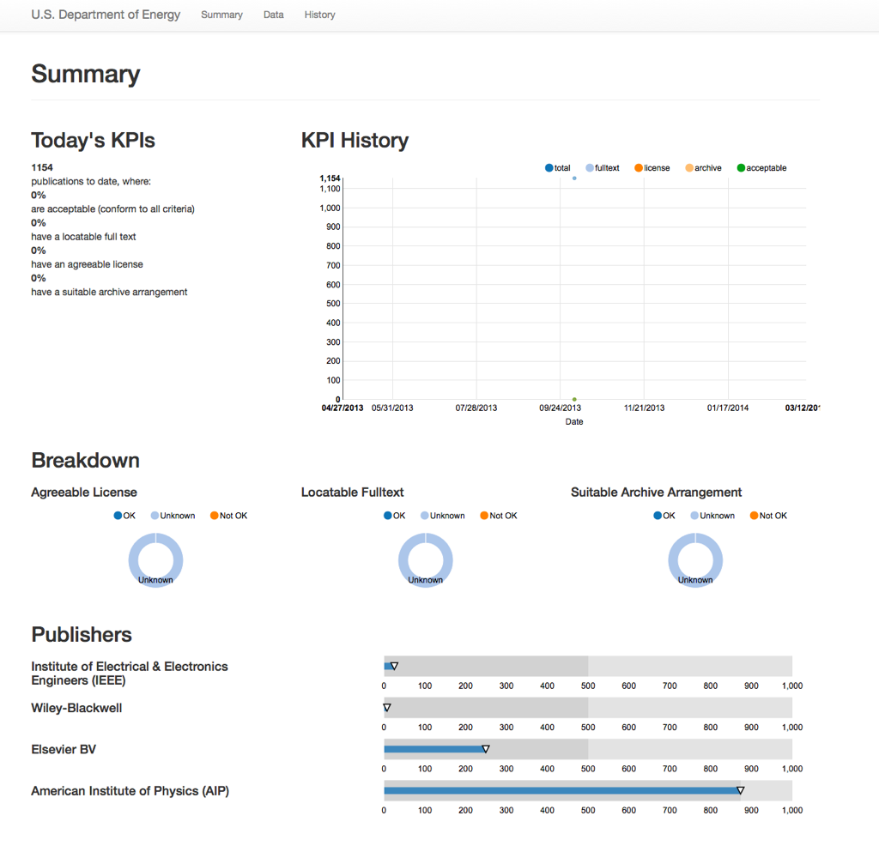
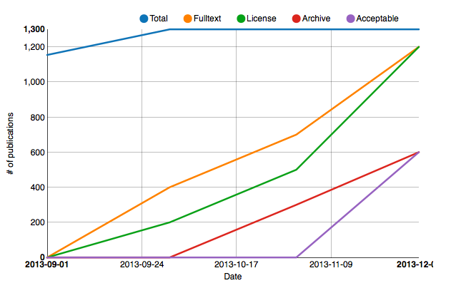
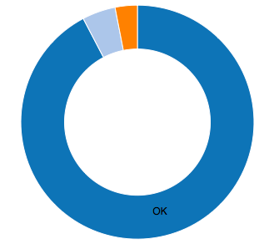
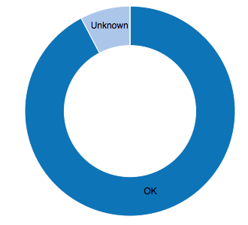
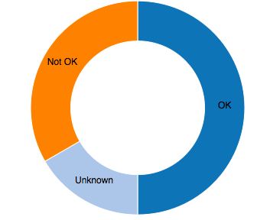
http://dashboard.chorusaccess.org/usdoe
Pilot Estimates
1,300
600
1,200
1,200
600
# Deposits
funded by
US DOE
# Records
having DOE
approved
licenses
Content tested for public
accessibility
# Deposits made to dark archives
approved by
US DOE

Slide 13
Publisher FundRef Records
Live CHORUS DOE dashboard:
http://dashboard.chorusaccess.org/usdoe

Slide 14
Service 2. Discovery Service (website & API)
Discovery service for content resulting from agency-funded research. Agencies can use API to feed their own portals. CHORUS website can be used by end users. Customized versions of CHORUS website can be created for agencies.
What:
enables user to search across bibliographic metadata
links to publisher site (BAV = AM or VOR)
download list of results in CSV for analysis
facet (filter) by sub-organization
facet (filter) by parent organization
facet (filter) by content type (e.g., book, journal, dataset, conf proceeding, component)
facet (filter) by year of publication
facet (filter) by subject category (e.g., physics, astronomy, …)
facet (filter) by year of publication
facet (filter) by publisher
cite any result using Citation Style Language (CSL) defined format
Future
facet (filter) by author/ORCID (to come)
add to ORCID profile
import results into reference manager software (via COinS)
see if result has been cited by patents (in progress)
number of times result is cited (CrossRef Cited By Service/Scopus/Web of Knowledge)
service open to public
powered by

Slide 15
search.chorusaccess.org
search.chorusaccess.org
powered by

Slide 16
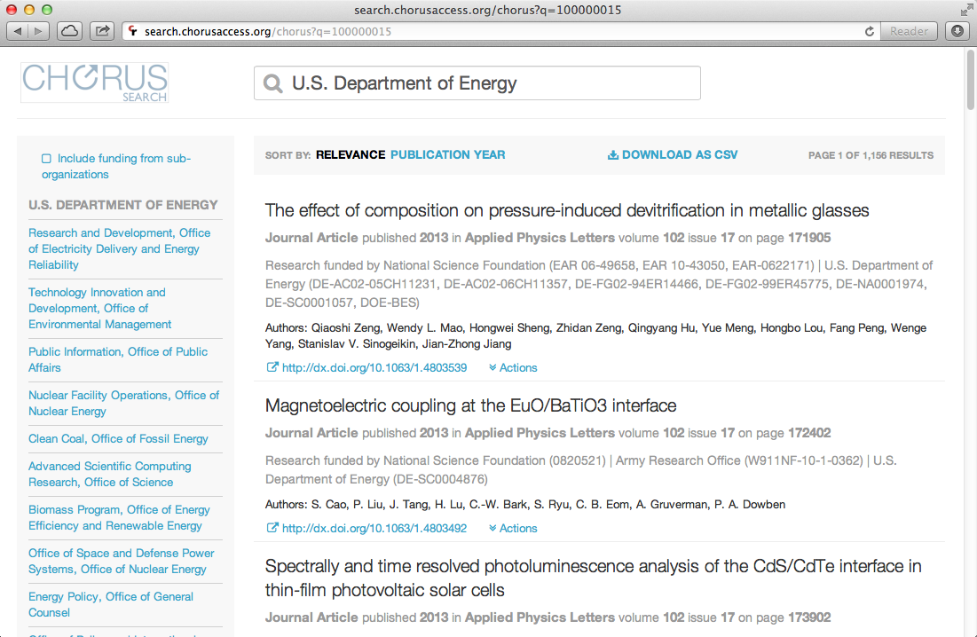
powered by

Slide 17
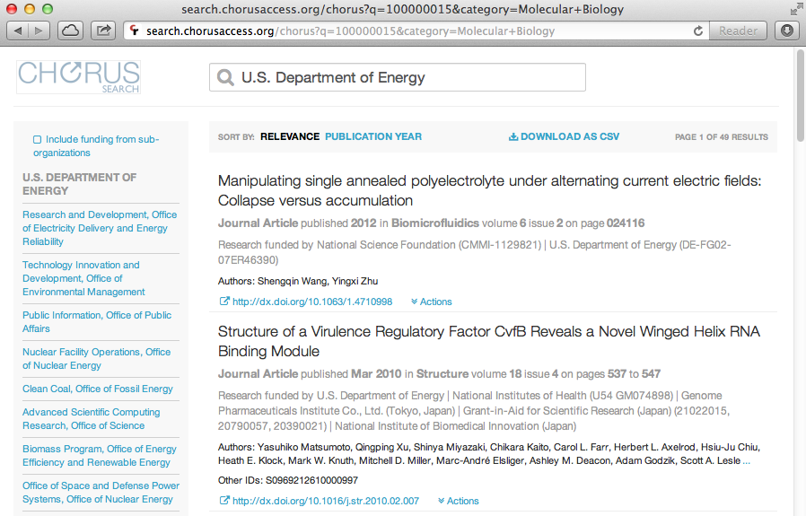
powered by

Slide 18
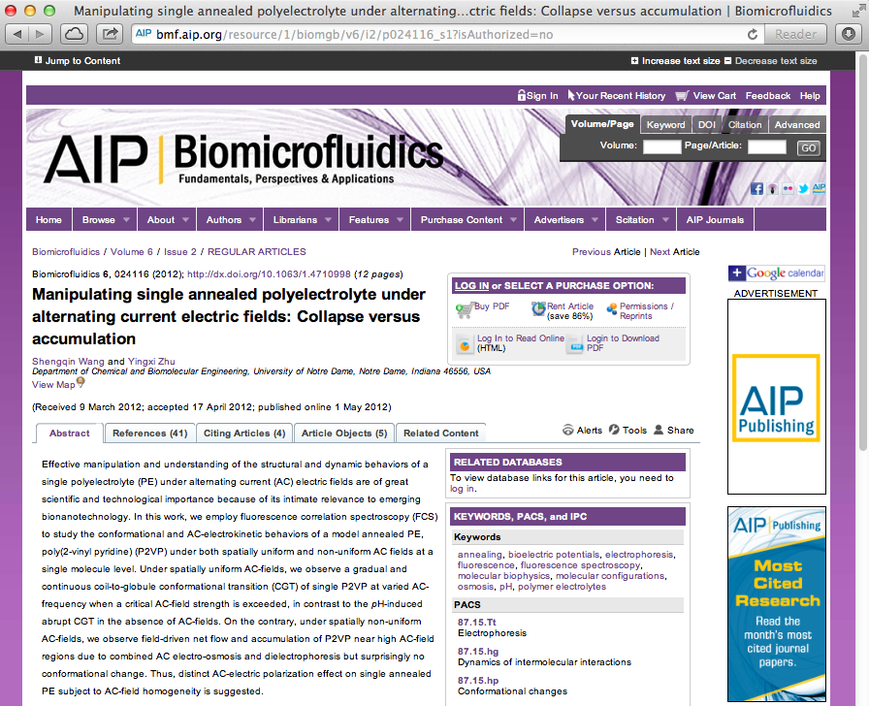

Slide 19
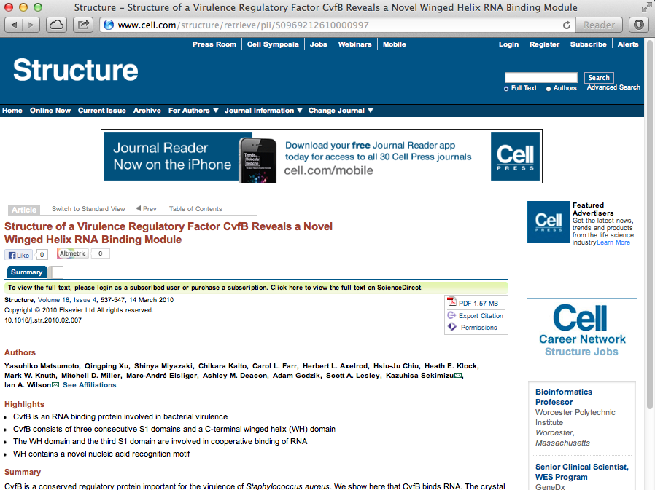

Slide 20
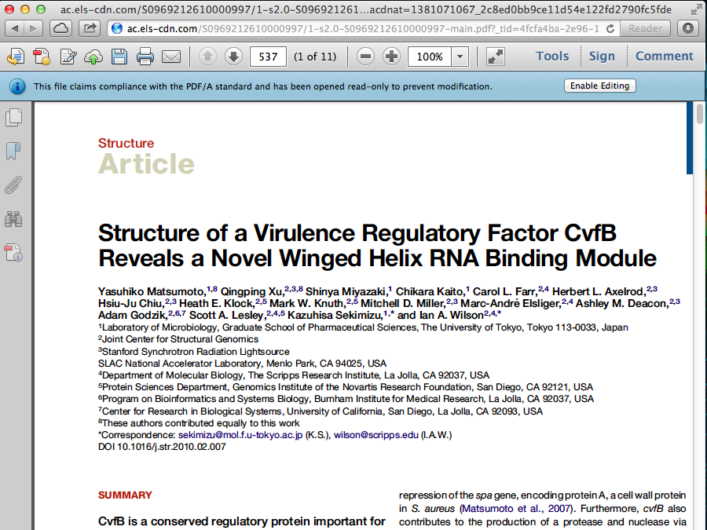

Slide 21
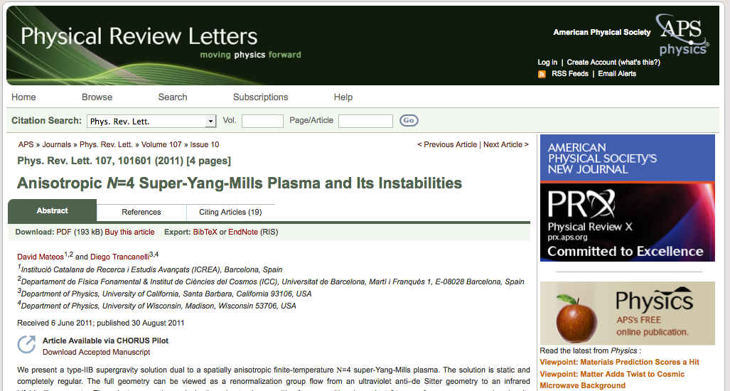
American Physical Society (APS) Author Manuscript
http://dx.doi.org/10.1103/PhysRevLett.107.101601

Slide 22
API Integration DOE’s PAGES Example
Public Access Gateway for Energy and Science (PAGES): (courtesy of W. Warnick, DOE-OSTI)
Objective to provide public access to the “best available version” of a DOE-affiliated publication (q.v. the publisher’s Version of Record (VoR) if it is available).
PAGES will ingest CHORUS metadata via API and will link to publishers best available version (the VoR or the Accepted Manuscript).
CHORUS will allow full-text indexing of articles via API to enhance PAGES search precision.
FundRef – will enable agencies and CHORUS to accurately identify agency-specific publications and monitor public access compliance
www.osti.gov/pages

Slide 23
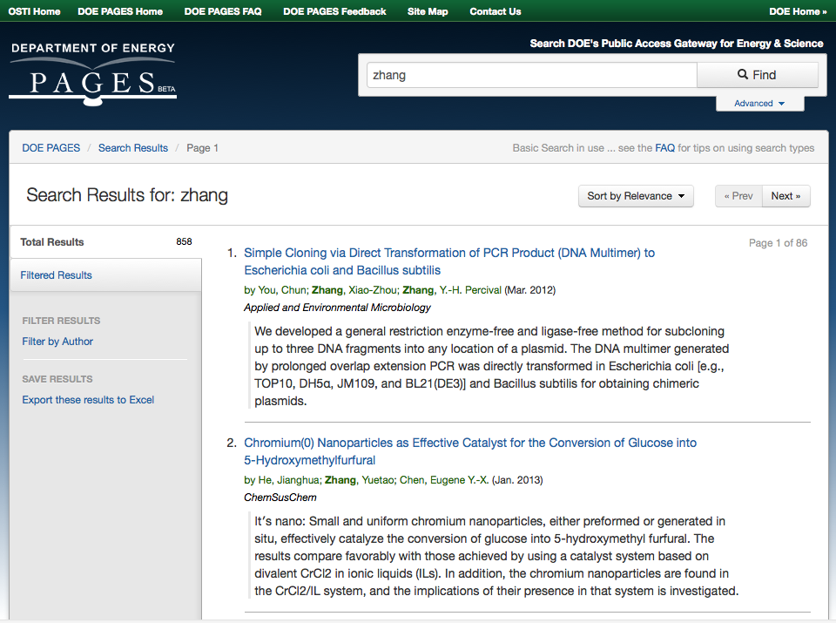
API Integration with Agency Portals

Slide 24
Service 3. Text Mining Using CrossRef’s Prospect Service
The Issue
Researchers are increasingly interested in text and data mining (TDM) published scholarly content.
Both Researchers and Publishers find it impractical to negotiate multiple bilateral agreements.
All would benefit from technical standards to enable TDM (APIs and data representations).
The Idea
CrossRef’s Prospect service provides:
Common API used by researchers to access the full text of content identified by CrossRef DOIs across publisher sites regardless of their business model.
License Registry
transparently shows what terms apply
provides “click-through” agreement of TDM licenses if needed

Slide 25
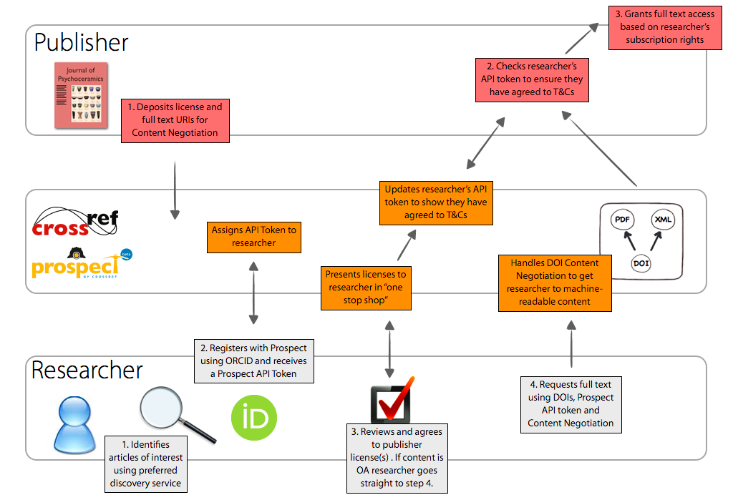
Service 3. Text Mining using CrossRef’s Prospect Service

Slide 26
Service 4. Digital Preservation with Agency Controlled Triggers
The STM publishing and library communities have collaborated for nearly two decades to build systems for archiving and long-term preservation of scholarly content in digital formats.
Preservation Agreements (Publishers ⬄ Archives)
CHORUS participants must have preservation agreements covering all the titles in which articles from agency-funded research appear
2) Archival Metadata
CHORUS needs to document the archiving arrangements and make that visible in the dashboard
Trigger Terms & Conditions
Agencies want be involved in specifying trigger conditions
CHORUS may develop a standard modification to the archiving agreements All publishers would need to execute amendments to their archiving agreements CHORUS will maintain dashboard to monitor status
Government maintained or other 3rd-party dark archive

Slide 27
CHORUS Trigger Events
DRAFT
Publisher No Longer in Business - The publisher is no longer in business or is no longer in the business of publishing content or providing access to previously published content and there are no successor interests or reversions or transfers of rights;
Title No Longer Offered - The publisher has stopped publishing and is no longer providing access to the content and there are no successor interests or reversion or transfer of rights;
Catastrophic Failure - While still publishing content, the publisher is not able to provide access to the content electronically due to technical or similar catastrophic failure.
Article No Longer Accessible – Full text is inaccessible to the public.

Slide 28
Digital Preservation Use Cases
DRAFT
1. Publisher closes public access to Public Access article (post-embargo) (for whatever reason)
Solution: CHORUS triggers the lighting of the article based on agency criteria
CHORUS Alerts are sent to publisher and agency
Agency contacts publisher to determine cause and impact (email, phone, etc.)
If not resolvable, Agency or CHORUS triggers the lighting of the article
Agency or CHORUS instructs Host Archive to make article publicly accessible
Agency redirects links for that article on their portal system to Host Archive
2. Publisher reopens public access to Public Access article (post-embargo) Solution: CHORUS triggers the darkening of the article based on agency criteria
CHORUS Alerts are sent to publisher and agency
Agency confirms access
Agency or CHORUS triggers the darkening of the article
Agency or CHORUS instructs Host Archive to make article inaccessible
Agency redirects links for that article on their portal system back to publisher URL via CrossRef

Slide 29
Digital Preservation during Pilot Phase 1 (September-December 2013)
Agreements between:
CHORUS and Pilot Publishers – including requirement to supply PDFs to Host Archive Service (for files currently publicly accessible and in pilot)
CHORUS and Host Archive Service (Deep Web Technologies)
CHORUS and Agency (e.g., US DOE)
Technical Options
Ingest
Pilot publishers send PDFs (currently publicly accessible) directly to Host Archive Service
or
Pilot publishers instruct ingestion service (CLOCKSS, Portico) to send relevant PDFs directly to Host Archive Service

Slide 30
Digital Preservation Post-Pilot Phase 2 (starting January 2014)
CHORUS will continue to work with agencies and existing digital preservation services such as CLOCKSS and Portico to determine whether the existing operational processes between publishers and these archiving services can be incorporated into the CHORUS system to increase efficiency while still giving agencies the needed level of control over trigger events.

Slide 31
Full Text Access & Auditing Post Embargo
Publisher
Presentation
Site
HTML
Researchers & Public
Wants to read
Publisher Landing Page
Publisher Access Control
DOI/URL
PDF
Wants to audit
Audit accessibility and archiving against publisher agreed rules
DOI/URL
Government
Agency
Wants to index
DOI/URL
Publisher Content Management Site
XML & components
PDF
Wants to archive
Hosting Archive Service
Ingestion Service
DOI/URL
31

Slide 32
Draft Goals of Pilot (1 of 2)
Show how publishers can work together to broaden access to content
Demonstrate public-private partnership between publishers and agencies
Demonstrate that the system can point to publicly accessible content on publisher sites in a cost efficient and consistent manner
Demonstrate that a dashboard can be used to check on publisher contributions and provide much needed transparency
Uncover issues with archiving publicly accessible content with agency controlled triggers

Slide 33
Draft Goals of Pilot (2 of 2)
Uncover needs and desires of agencies and publishers (for example, intramural vs. extramural research workflows)
Integrate with agency portals as they are available
Think through legal agreement issues between publishers, agencies and service providers
Streamline and bring focus to publisher internal processes regarding implementing the CHORUS services
Develop a well documented method for participation in CHORUS by publishers and agencies
Help facilitate open discussion between publishers, agencies, institutions, libraries, researchers and public stakeholders by analyzing and making the pilot system public

Slide 34
What Do Publishers Need To Do?
Become a signatory of CHORUS
Become a member of CrossRef
Sign up for FundRef as part of CrossRef membership
Submit Agency Related data to FundRef for all new content
Send License and Embargo metadata to CrossRef
Deposit full text URIs with CrossRef Prospect
Sign CHORUS Pilot Agreement
Send relevant content to host archive service

Slide 35
Ramp up
Jan –
June 2013
Proof of
Concept
Delivered 30 Aug
Pilot Tech
Build
Delivered 30 Sept
Pilot
Phase
30 Sept -
31 Dec
2013
Pilot
Review
Begins
Jan 2014
Production
Early
2014
AAP Startup Funding
July 2013
Incorporation
of CHOR Inc.
1 Oct 2013
Fundraising

Slide 36
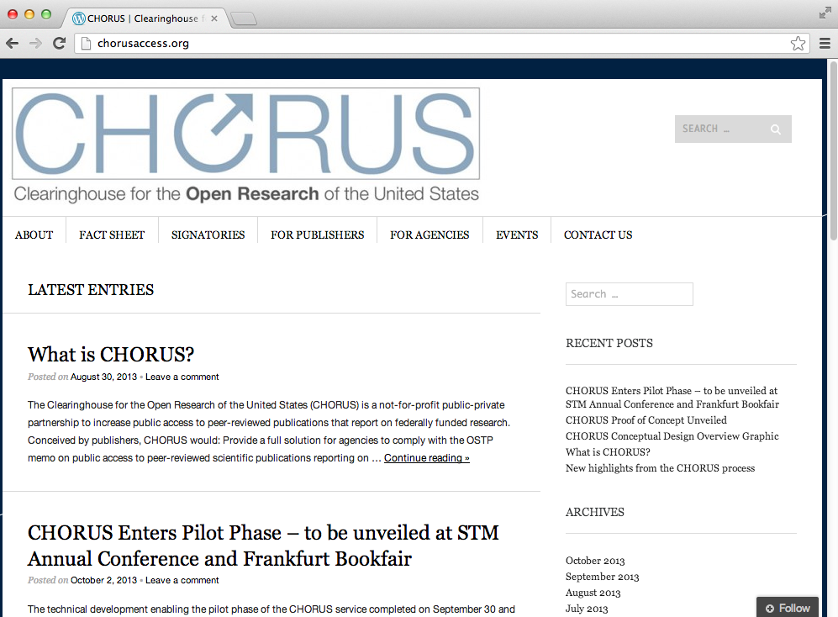

Slide 37
Sign up today! www.chorusaccess.org
or contact me:
Howard Ratner
hratner@chorusaccess.org

Slide 38
Appendix

Slide 39
Steering Committee
David Crotty, Oxford University Press
Scott Delman, ACM
Fred Dylla, American Institute of Physics
Patrick Kelly, John Wiley & Sons
Thane Kerner, Silverchair
Susan King, American Chemical Society (Chair)
Howard Ratner, CHORUS
Joe Serene, American Physical Society
John Tagler, PSP/AAP
David Weinreich, PSP/AAP
Alicia Wise, Elsevier
Fran Zappulla, IEEE
Advisors
Ed Pentz, CrossRef

Slide 40
Technical Working Group
Thane Kerner, Silverchair (co-chair)
Howard Ratner, CHORUS (co-chair)
Geoffrey Bilder, CrossRef
Elizabeth Crellin, Oxford University Press
Paul Dlug, American Physical Society
Mark Doyle, American Physical Society
Gerry Grenier, IEEE
Wayne Graves, ACM
David Martinsen, American Chemical Society
Chris McMahon, American Institute of Physics
Chris Shillum, Elsevier
Evan Owens, American Institute of Physics
Craig Van Dyck, John Wiley & Sons
John Walker, John Wiley & Sons
Advisors
Mark Martin, Office of Scientific and Technical Information, US DOE

Slide 41
Supporting Organizations (October 1, 2013)
Publishers
ACM
Acoustical Society of America
American Association for the Advancement of Science
American Association of Anatomists
American Association for Cancer Research
American Association of Physicists in Medicine
American Association of Physics Teachers
American Astronomical Society
American Chemical Society
American Crystallographic Association, Inc.
American College of Chest Physicians
American College of Physicians
American Dental Association
American Diabetes Association
American Geophysical Union
American Institute of Aeronautics and Astronautics
American Institute of Biological Sciences
American Institute of Physics
American Mathematical Society
American Meteorological Society
American Medical Association
American Nuclear Society
American Physical Society
American Physiological Society
American Psychiatric Publishing
American Psychological Association
American Society for Microbiology
American Society of Agricultural & Biological Engineers
American Society of Civil Engineers
American Society of Mechanical Engineers
American Society of Plant Biologists
American Speech-Language-Hearing Association
Association for Research in Vision and Ophthalmology
AVS: Science & Technology of Materials, Interfaces and Processing
Biophysical Society
Bioscientifica
Botanical Society of America
BMJ
Cambridge University Press
Columbia University Press
Duke University Press
Ecological Society of America
Elsevier
Emerald Group Publishing Limited
The Endocrine Society
Entomological Society of America
Fabricators and Manufacturers Association, International
Genetics Society of America
Human Factors and Ergonomics Society
IEEE
iMedPub. Internet Medical Publishing
Institute of Physics Publishing
Journal of Bone and Joint Surgery
Journal of Rehabilitation Research and Development
Lynne Rienner Publishers, Inc.
Materials Research Society
McGraw-Hill
Mycological Society of America
New England Journal of Medicine
The Optical Society
Oxford University Press
The Physiological Society
The Royal College of Psychiatrists
The Royal Society
Royal Society of Chemistry
Society for the Advancement of Materials on Process Engineering
Society for the Study of Reproduction
Springer Science+Business Media LLC
Taylor & Francis
Thieme Publishers
University of Chicago Press
John Wiley & Sons
Wolters Kluwer Medical Research
Service Providers and Other Organizations
Association of Learned and Professional Society Publishers
CrossRef
DC Principles Coalition
International Association of Scientific, Technical and Medical Publishers (STM)
Publishing Technology
Silverchair Science+Communications, Inc.

